Slide 1

R.M. of Corman Park No. 344 Annual General Meeting
October 18, 2017

Slide 2
Agenda
Call to Order
Introduction of Council & Staff
Nomination of Chair
Consideration of Agenda
2016 Annual General Meeting Record of Proceedings
Crime Watch – S/Cst. Jay Slack, RCMP Community Constable
Council Report – Reeve Judy Harwood
Administration Report – Adam Tittemore, Administrator
Public Works Report – Craig Habermehl, Director of Public Works
Planning Report – Rebecca Row, Director of Planning & Development
Corman Park Police Service – John Garnet, Chief of Police
2017 Citizen of the Year Award
Open Floor
Adjourn

Slide 3
Introductions R.M. of Corman Park Council & Staff

Slide 4
Nomination of Meeting Chairman

Slide 5
Consideration of Agenda

Slide 6
2016 Annual General Meeting Record of Proceedings

Slide 7

Rural Crime Watch

Slide 8
Council Report
Judy Harwood
Reeve
R.M. of Corman Park
Notes:
Good evening…thank you

Slide 9
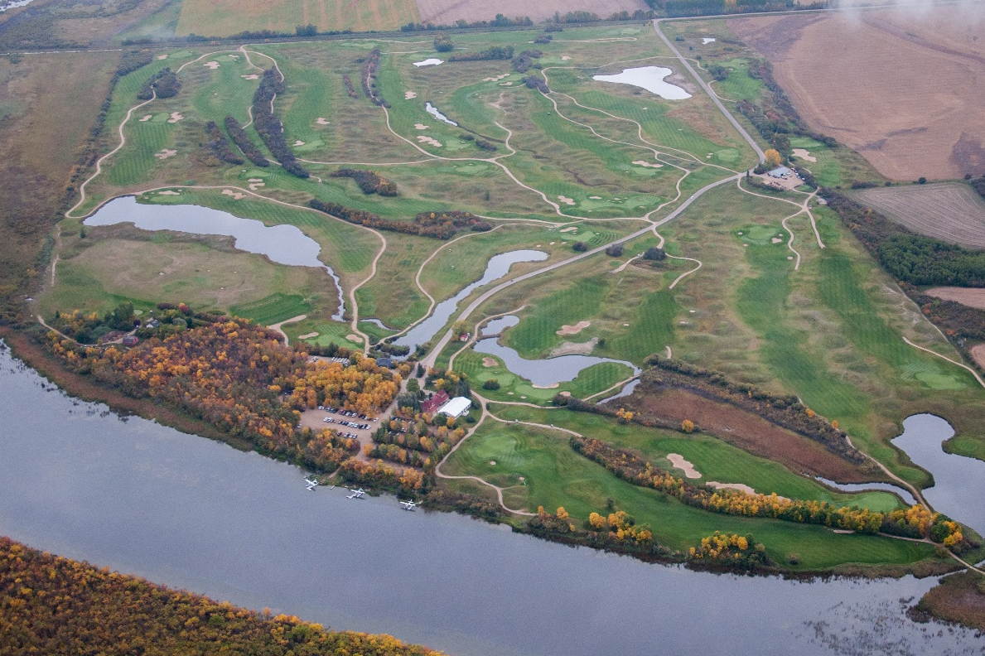
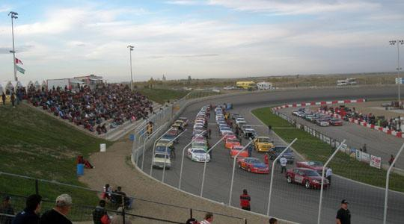
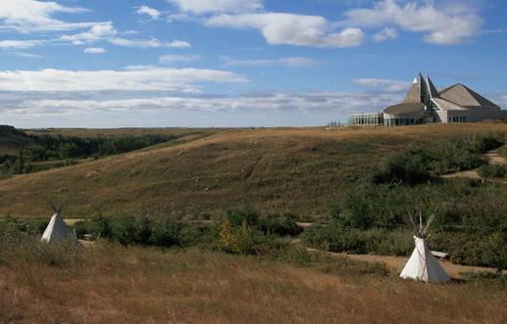
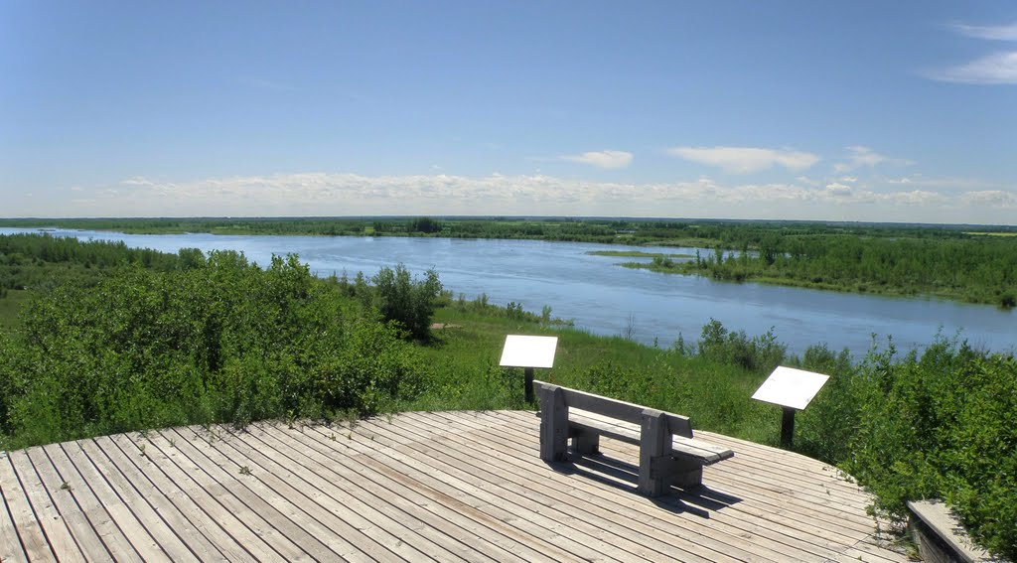
Moon Lake Golf Course
Wyant Group Raceway
Wanuskewin Heritage Park
Cranberry Flats Conservation Area

Slide 10
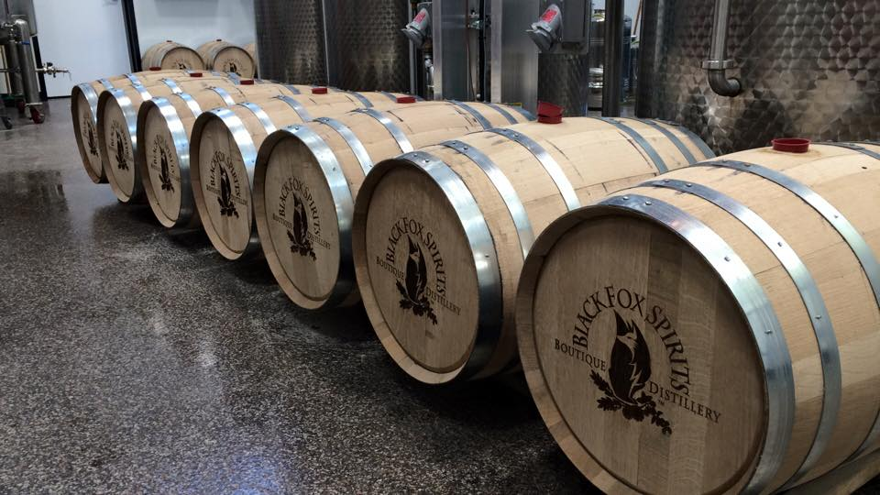

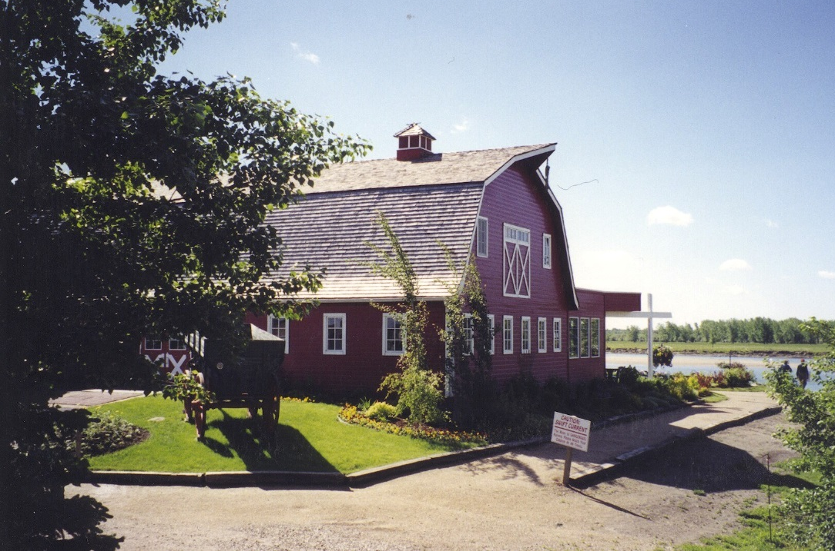
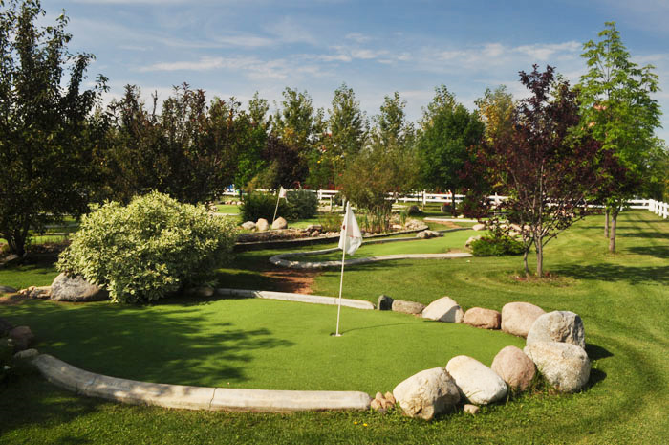
Black Fox Distillery
The Strawberry Ranch
The Berry Barn
Crickle Creek Fun Zone

Slide 11
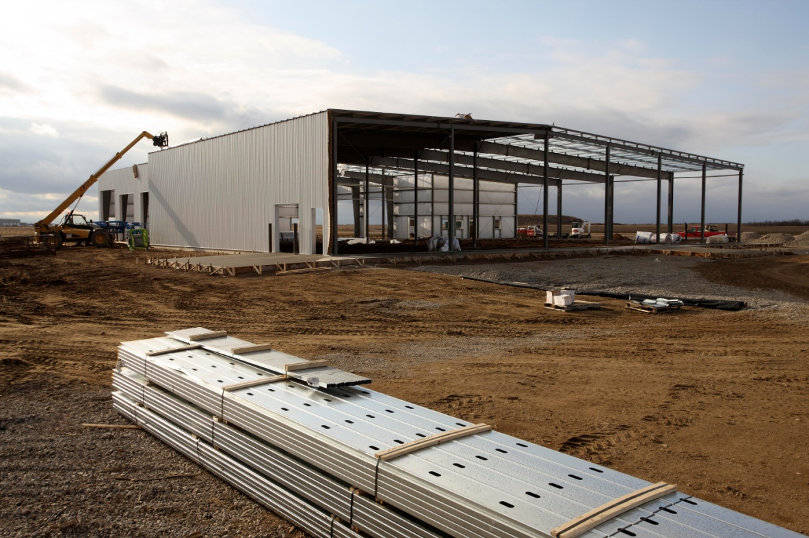
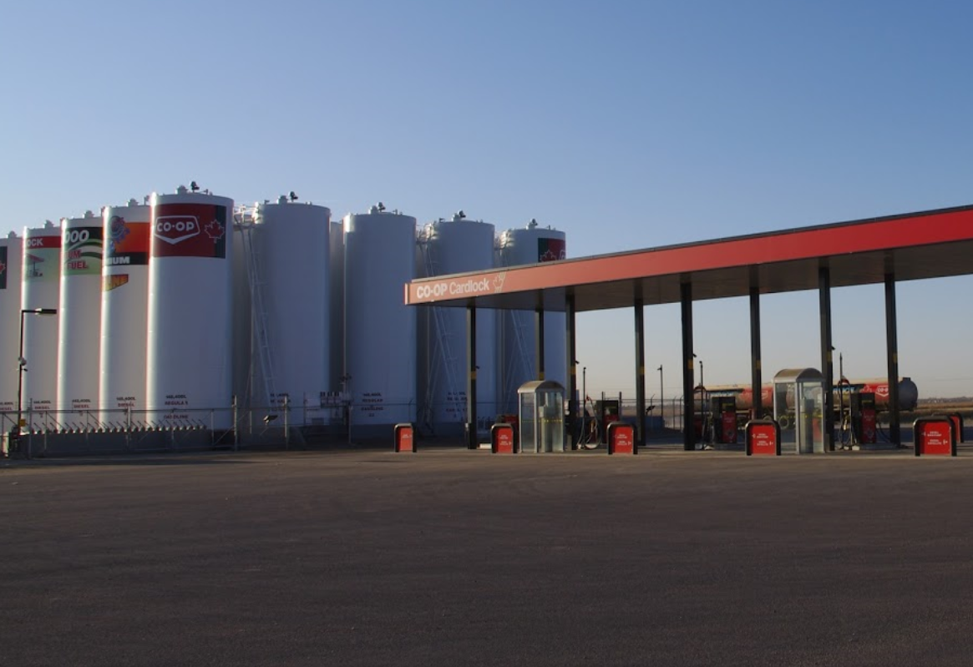
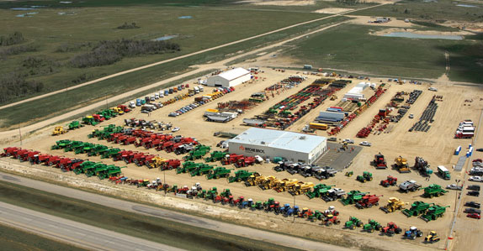
Industrial Development
Co-op Cardlock - BizHub
Ritchie Bros Auctioneers Ltd.

Slide 12
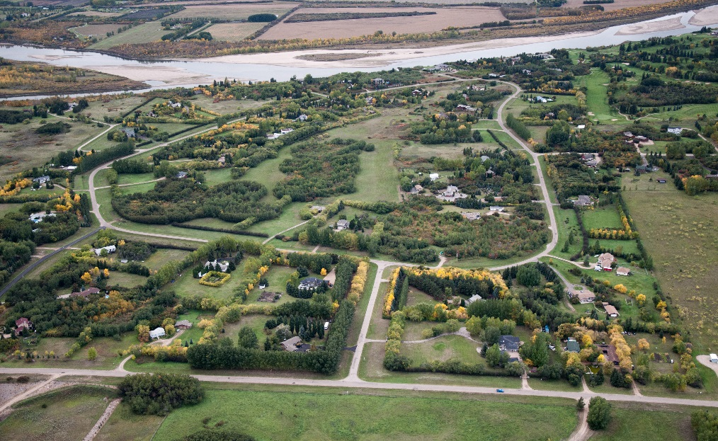
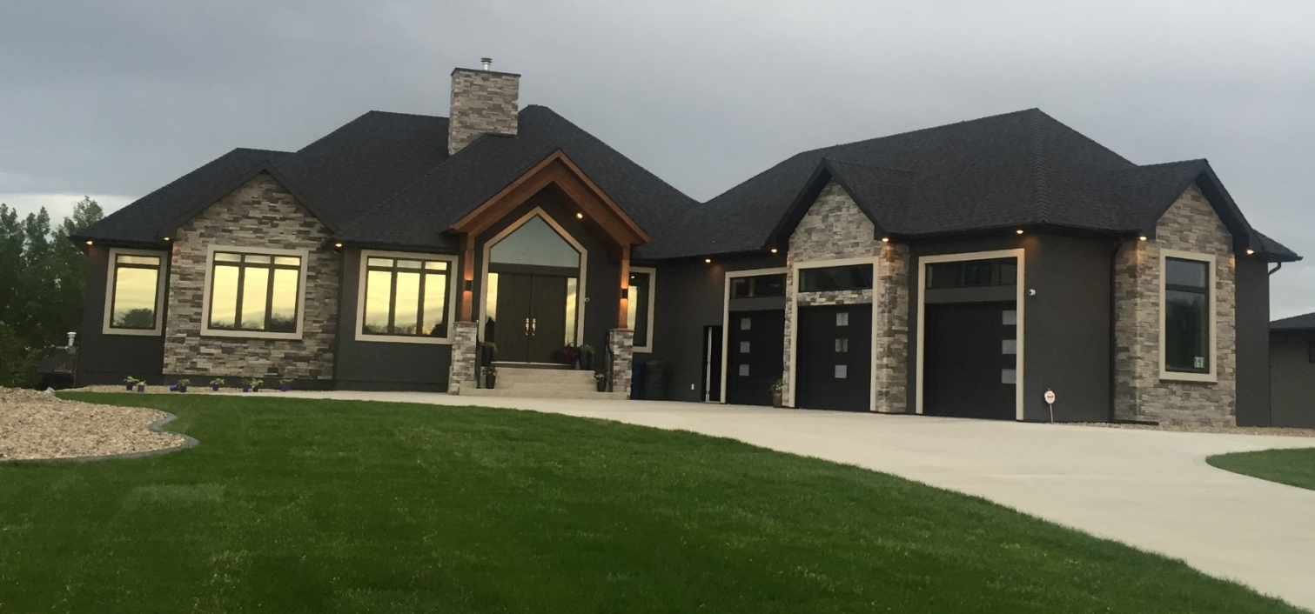
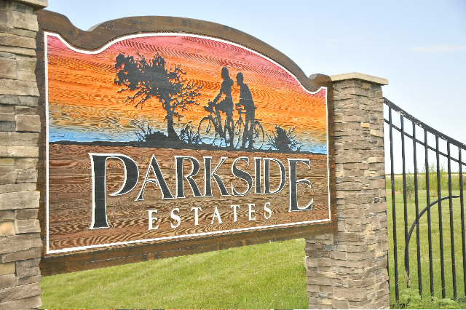
Rural Lifestyle Choices

Slide 13
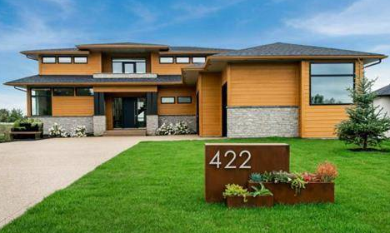


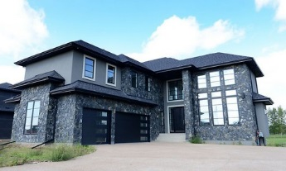
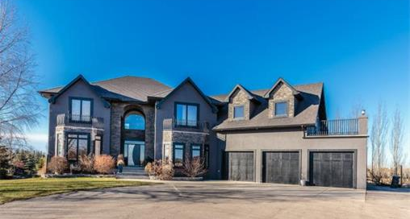

Slide 14
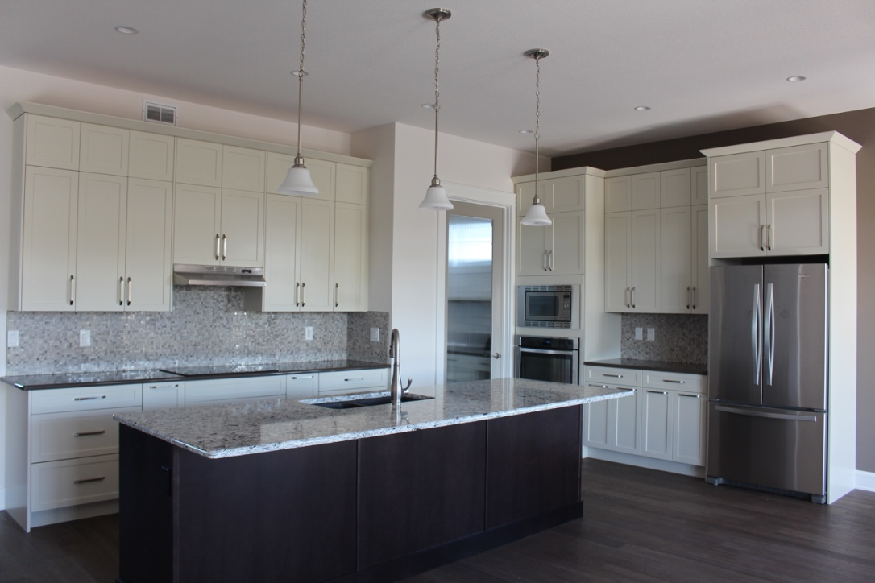
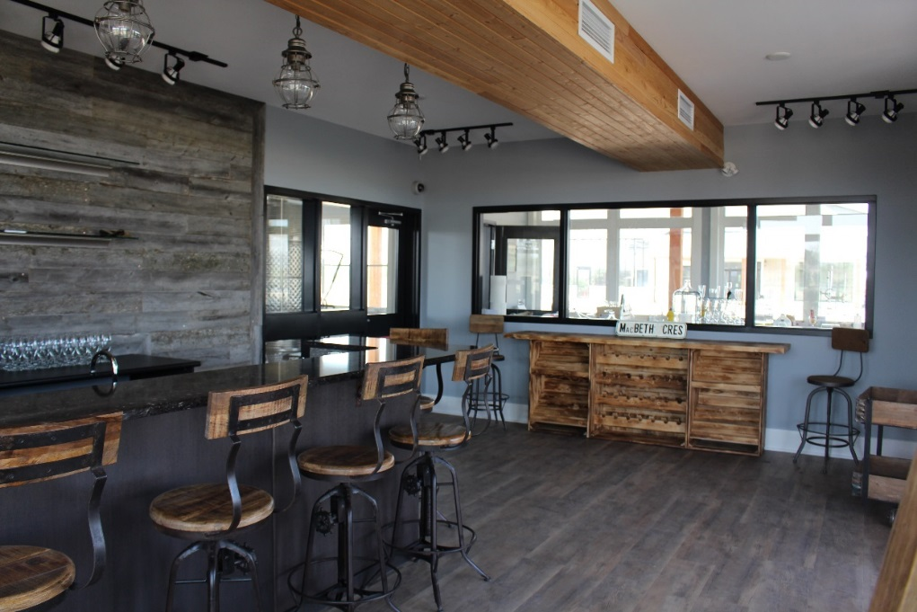
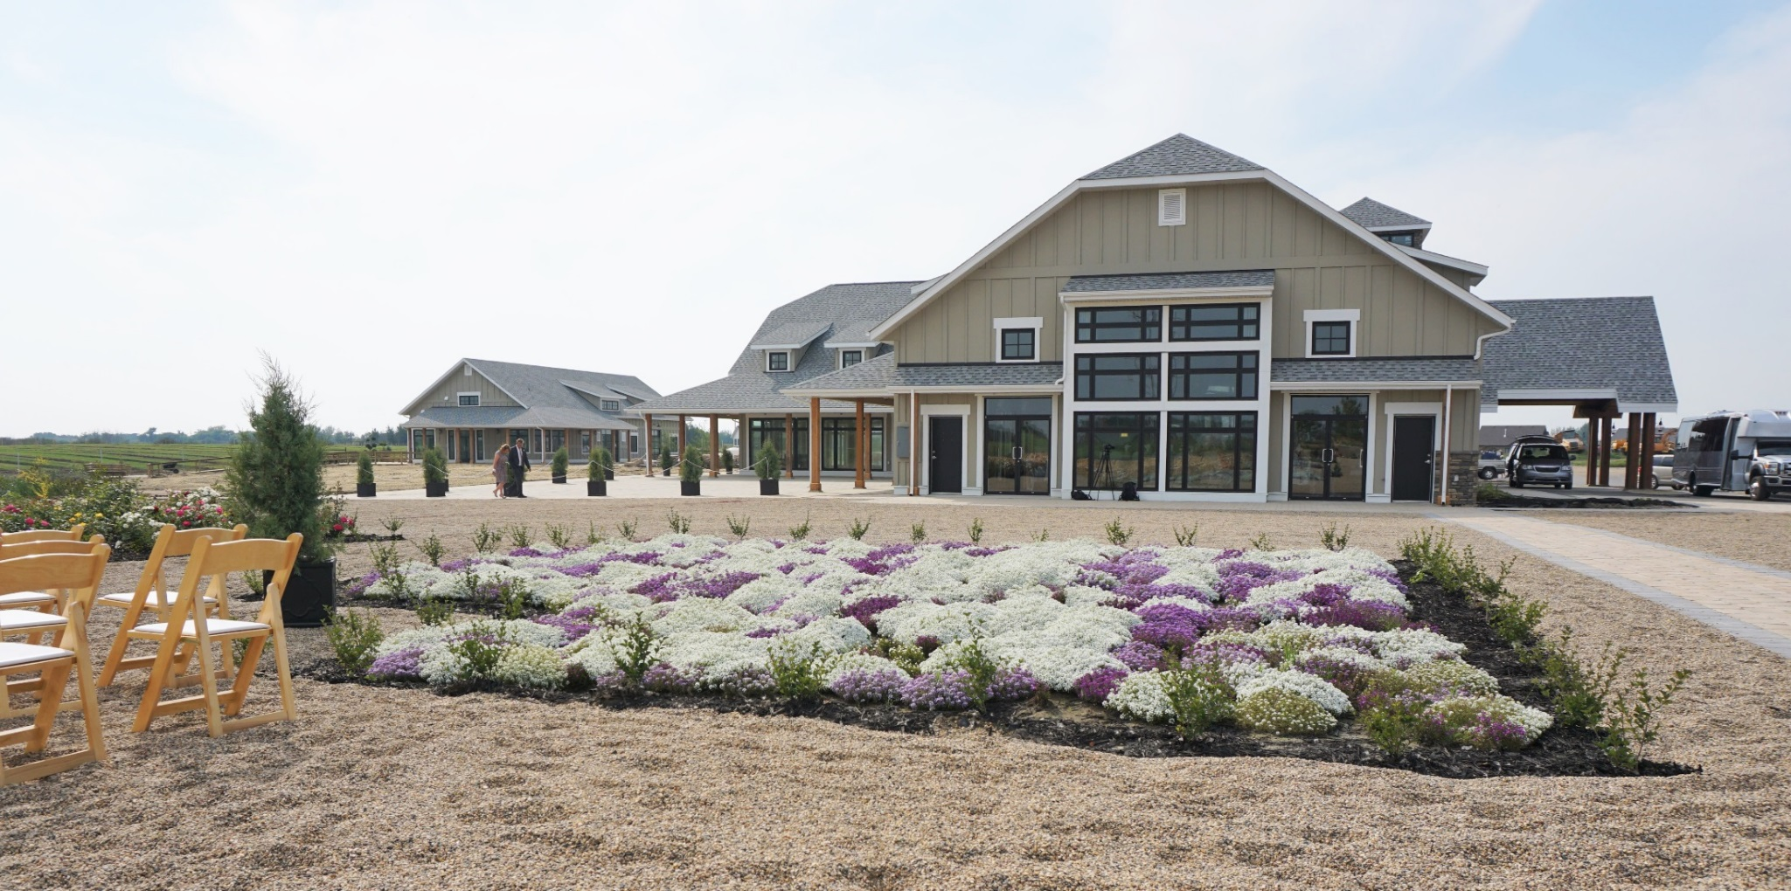
Crossmount
Cider Co.
The Village at Crossmount: Event Centre

Slide 15
Administration
Adam Tittemore
Administrator

Slide 16
Overview
Ensure municipal operations are completed in an efficient manner
Ensure Bylaws and resolutions of Council are implemented
Make recommendations to Council on legislative decisions
Long term planning

Slide 17
Departments
Administration
Finance, Taxes, Utilities, Assessment
Public Works
Roads, Utilities, Permitting, Drainage, Mapping, Mowing
Planning & Development
Zoning, Subdivisions, Planning, Permits, Enforcement
Weed Control
Pest Control
Protective Services

Slide 18

2016 Financial Information
Operational Revenues $15,816,465
Operational Expenditures $12,244,769
Operational Surplus $3,571,696
Capital Investment $5,364,575
Valley Road 3 Year Project
Capital Equipment
- East Cory Local Improvement Project
Notes:
The RM of Corman Park is committed to re-investing dollars in the community and providing a high level of service to its ratepayers. Investments are being made in renewing our capital equipment and infrastructure. In 2016, we continued to update our aging fleet with the purchase of a dozer and 2 new graders. The RM also had a number of large capital projects which include:
East Cory Local Improvement Project at a cost of 2.4 Million
Phase 1 of Valley Road Project; 3 Year project to cost approximately $3.2 Million

Slide 19

Notes:
The total operations budget is approximately $14.6 Million.
The RM also collects approximately $11.9M in education property taxes which is distributed to the Prairie Spirit and St. Paul’s School Divisions.

Slide 20

2017 Budget Highlights
Net Capital Investment of $3.4 Million includes:
Phase 2 of Valley Road Project
Fibre Optic Upgrade to the Hamlets of Casa Rio and Cedar Villa
Replacement of 3 Graders in Public Works Fleet
Notes:
Phase 2 of Valley Road - $1.25 Million
Hamlet Fibre Optics Upgrade – 300K
3 Graders – $1 Million to help service our 2 additional grader zones in 2017.

Slide 21

Assessment & Taxation
Assessment
Mill Rate
Appeal (2017 Revaluation)
TIPPS Program
*Tax payments must be received by
December 31, 2017*
Notes:
Average change in assessment: (Uniform Mill Rate was 4.60)
Agriculture 133%
Residential 24%
Commercial 49%
Agriculture assessments increased on average 119% in the province;
As a result of this assessment increase; revenue from the agriculture class increased to 13% of the total municipal tax levy (compared to 8% in 2016)
Tax revenues generated from the commercial and residential class was status quo (same as 2016)
Education Property Taxes which are set by the province had a 16.37% overall increase from 2016
RM had 140 appeals in 2017 revaluation year;
- Currently 267 applicants on TIPPS, convenient and easy method of payment; forms are available on our website

Slide 22

Community Funding
Saskatchewan Lotteries Funding
Community Facility Funding
Non-Profit Grant Program
SARM Scholarships

Slide 23

Long Term Planning
Strategically allocating funds for future projects
Continue growth of Reserve Funds
Identify Alternative Revenue Sources to alleviate pressure on Property Tax Levy
Notes:
Ex: Alternative revenue sources include provincial and federal grant programs (Canada Building Fund, Waste Water Initiative Program)

Slide 24
Public Works Department
Craig Habermehl
Director of Public Works

Slide 25
Overview
1,030 Miles of Roadway
138 miles of hard surface roads
892 miles of gravel roads
Notes:
Overview
1,030 Miles of Roadway within the RM
138 miles of these roads are hard surfaced (chip sealed or pavement)
The remaining 892 miles are gravel roads.

Slide 26
Road Maintenance
12 Grader zones following a 10 to 14 day rotation depending on weather
Crack Filling & Sealing
Preventative maintenance on hard surface roads
500 Tonnes of Asphalt Patching Completed
Notes:
Road Maintenance
In the 2017 budget Council approved the addition of 2 graders zones.
There are 12 Grader zones following a 10 to 14 day rotation depending on weather
Crack Filling & Sealing
Preventative maintenance on hard surface roads
500 Tonnes of Asphalt Patching Completed
Levelling Courses done on sections of Neuhorst and Blumenheim Road

Slide 27
Gravel Program
Three Year Rotation
45,000 yd3 of gravel applied in the 2017 gravel program
5,000 yd3 of gravel applied to road construction and additional projects
400 Miles of Road Received Gravel in 2017
Notes:
Gravel Program
Three Year Rotation
45,000 yd3 of gravel applied in the 2017 gravel program
5,000 yd3 of gravel applied to road construction and additional projects
400 Miles of Road Received Gravel in 2017

Slide 28
Gravel Road Construction
In House
5.0 Miles of road constructed
1.5 miles on previously flooded out roads
Contracted
7.4 Miles of road construction
Notes:
Gravel Road Construction
2017 was a excellent construction season largely based on the dry weather.
In House
5.0 miles of road constructed
<>1.5 miles previously flooded out roads
Contracted
7.4 miles miles of road construction
<>5.5 miles of rock mulching
<>1.6 miles of soil stabilization
<>0.3 miles of general road buildup

Slide 29
Hard Surface Road Construction
In House
7.2 Miles of roads seal coated
Contracted
4.4 Miles of roads paved
4.1 Miles on Valley Road
Double gated culvert replacement near Berry Barn
0.3 Miles on Twp Rd 362A
Notes:
Hard Surface Road Construction
In House
7.2 miles of roads seal coated
Contracted
4.4 Miles of roads resurfaced
<>4.1 miles on Valley Road
<>Double gated culvert replacement near Berry Barn
<>0.3 miles on Twp Rd 362A

Slide 30
Water Systems
5 Municipally Operated Water Systems
Riverside
Casa Rio
Grasswood
Industrial Park
Battleford Trail
4 Water Tank Fill Stations
Clarence Well
North Well
33rd street
Pasture Road – Non Potable
Notes:
Water Systems
5 Municipally Operated Water Systems
Riverside
Casa Rio
Grasswood
Industrial Park
Battleford Trail
4 Water Tank Fill Stations
Clarence Well
North Well
33rd street
Pasture Road – Non Potable

Slide 31
Recycling Program
4 Recycling Stations
Green Prairie Environmental
Osler
Langham
33rd St
1 New Transfer Station opening near Asquith, SK
Notes:
Recycling Program
4 Recycling Stations
Green Prairie Environmental
Osler
Langham
33rd St
Construction is currently underway for the new Transfer Station opening near Asquith, SK

Slide 32
Mowing Program
Full cut on a four year rotation
Five mowers operating during mowing program
Notes:
Mowing Program
Full cut on a four year rotation
Five mowers operating during mowing program

Slide 33
Other Services
3 Miles of Road Brushing Completed
10 Culverts Installed
Rock Picking on 0.5 miles of road
Notes:
Other Services
3 Miles of Road Brushing Completed
10 Culverts Installed
Rock Picking on 0.5 miles of road

Slide 34
Planning Department
Rebecca Row
Director of Planning & Development

Slide 35
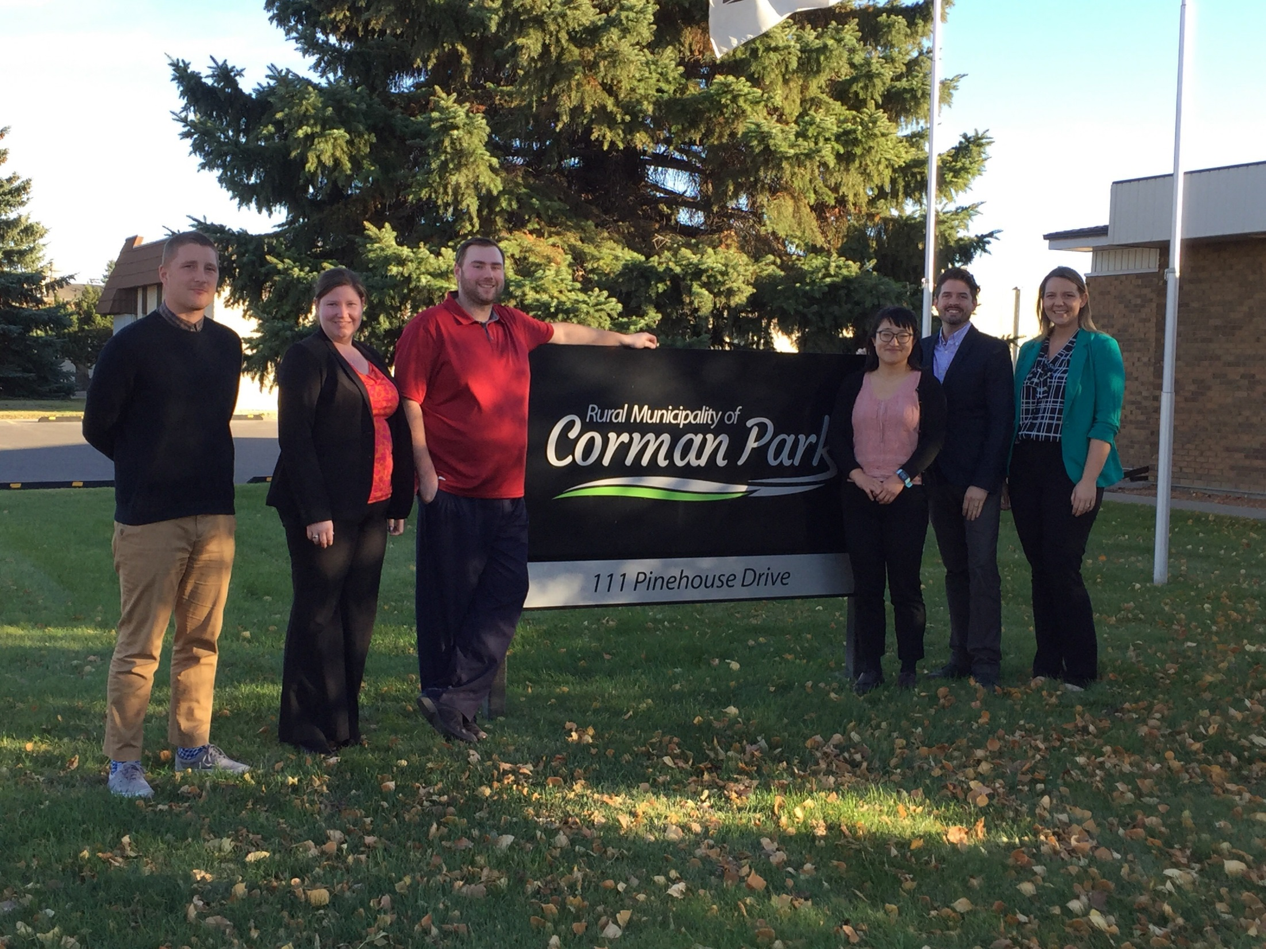
R.M. Planning Team
(Left to Right) James McKnight – Planner II, Michelle Reiter – Planning Technician, Cory Boudreau – Planner I, Vicky Reaney – Senior Planner, Kelby Unseth – Planner II, Rebecca Row – Director of Planning
Notes:
All of Corman Park's various planning, permitting and subdivision processes are managed by the R.M. Planning Department. The planners also provide guidance on land use and zoning to R.M. Council, ratepayers and the development industry.

Slide 36
R.M. Planning Overview
Zoning Compliance Certificates
Development and Building Permits
Basic Development Reviews (BDR)
Minor Subdivision and/or Rezoning Applications
Comprehensive Development Reviews (CDR)
Major Subdivision and/or Rezoning Applications
Bylaw Amendments
Map and/or Text
Notes:
Zoning Compliance Certificates confirm that a property and any buildings on it have received permits and are compliant with R.M. bylaws and setbacks. These are usually requested during real estate transactions and are recommended for residential, agriculture and commercial/industrial properties.
An approved development permit is required in almost all instances in order to begin developing property or running a business. The RM has two development permit categories – permitted uses, which staff approve, and discretionary uses, which require Council approval.
Building permits differ from development permits in that they are required for construction and are reviewed for building code compliance.
Basic Development Reviews are required for single parcel subdivision or rezoning applications. They are intended to provide information on the site including servicing and confirmation of a safe, buildable area on the property.
Comprehensive Dev Reviews are required to rezone or subdivide land for multi-parcel country residential, commercial, industrial, or recreational purposes. They are more in depth and detailed than the BDRs I just spoke about as they often require technical studies such as a Traffic Impact Assessment or Geotechnical Report.
Bylaw amendments take on two forms within the R.M. Text amendments to our bylaws are required when a development standard needs changing in the Official Community Plan or Zoning Bylaw. Map amendments are done when rezoning takes place to official change and illustrate the zoning of a property.

Slide 37
Recent Statistics - Subdivisions
Notes:
I will now touch on some of our planning and development related statistics over the past few years.
Last year Corman Park approved 71 subdivisions; which was up 20% over 2015. Since 2013 we have seen steady subdivision approval increases due to our 5 per ¼ or 3 per 80 residential subdivision policies and new multi parcel developments.
As of September 30 of this year, we have approved 45 subdivisions, with another 17 currently under review.

Slide 38
Recent Statistics – Development Permits
Notes:
The R.M. issued a total of 282 development permits in 2016 which included permitted and discretionary use. That too was up 20% over 2015. 2016 was our busiest year of the past five years in terms of subdivisions and permits.
We’ve approved 209 development permits as of the end of September which is about 75% of last year.

Slide 39
Recent Statistics – Building Permits
2017 Q3 Value of Construction: $62,962,524
2017 Q3 Generated Permit Fees: $306,926
2016 Value of Construction: $62,861,452
2016 Generated Permit Fees: $314,713
Notes:
We issued 211 building permits in 2016 which was up about 10% over the year prior.
This resulted in another strong construction year with a value of almost $63 million which generated permit fees over $314,000.
As of the end of September this year we have issued 149 building permits. I am not expecting total permit number counts to be as high as last year; however if you look at the screen you will see our current year to date value of construction and permit fees are already equalling last year. And we still have 1 quarter left to go this year.
Corman Park has maintained strong construction levels over the past 5 years and hasn’t experienced the same fluctuations as other municipalities.

Slide 40
Recent Statistics - Bylaw Amendments
Rezoning Applications - 26 YTD, additional 9 under review
2017 policy/textual amendments include:
Mineral Resource Extraction Operation (i.e. gravel pits) Time Limits
Changed max. approval time from 2 years to 4 years
Work Camps & Other Temporary Uses
Provided for temporary uses, like a work camp, to be established
Industrial Districts
Created new business, light and heavy industrial Zoning Districts
Expanded list of allowable uses
Reduced minimum lot sizes to 2 acres
Intensive Livestock Operations
Currently reviewing ILO setback, co-existence agreements
Notes:
We have 26 rezoning approvals YTD, with an 9 additional under review
Over the past number of years we have made numerous textual amendments to our planning policy documents. Some of more notable policy amendments from this year include:
Aggregate Resource Extraction Operation Time Limits
Changed max. approval time from 2 years to 4 years (i.e. gravel pits)
Work Camps & Other Temporary Uses
Allowed a work camp to be located temporarily in the R.M.
Provided for other types of temporary uses to be established subject to conditions and time limits
Industrial Districts
Created new business, light and heavy industrial Zoning Districts
Created new allowable uses
Reduced minimum lot sizes to 2 acres
Intensive Livestock Operations
Council is currently reviewing ILO setback distances and the use of co-existence agreements

Slide 41
Recent Annexation Proposals
Annexation, also referred to as ‘boundary alteration’ is the legal process of altering municipal boundaries to add territory from one municipality to another
Municipalities will negotiate tax loss compensation or other agreements (i.e. road maintenance)
The planning and zoning bylaws of the R.M. will follow the land until the annexing municipality amends its bylaws to cover the new area
Notes:
Annexation, also referred to as ‘boundary alteration’ is the legal process of altering municipal boundaries to add territory from one municipality to another.
Municipalities undertaking annexation can negotiate tax loss compensation or other agreements.
The Minister of Government Relations will make an approving order for the annexation to come into effect.
Upon the effective date of an approving order, the lands will transfer from the administrative jurisdiction of the R.M. to another municipality.
The planning and zoning bylaws of the R.M. will follow the land until the annexing municipality amends its planning bylaws to ensure they appropriately cover the newly annexed area.

Slide 42
Recent Annexation Proposals
City of Martensville and Town of Dalmeny proposed boundary alteration in 2017
The R.M. and City of Martensville are still discussing the application
The R.M. gave a complementary resolution on October 16, 2017 for Dalmeny’s annexation proposal subject to:
Public notice;
Tax loss compensation of $8,517.60
Ensuring natural drainage is managed;
Allowance for expansion to a nearby ILO
The annexations are not in effect yet
Notes:
The City of Martensville and Town of Dalmeny proposed boundary alteration in 2017.
The R.M. and City of Martensville are still discussing the application
Dalmeny proposed to annex approx. a ¼ section and a half east of the town. The R.M. gave a complementary resolution on Monday for Dalmeny’s annexation subject to:
Public notice of the proposed annexation;
Dalmeny paying tax loss compensation of $8,500 to the RM
Dlameny ensuring natural drainage is managed and any changes do not affect neighbouring lands;
Agreement to waive the setback for expansion to a nearby ILO if applied for
The annexations are not in effect yet

Slide 43
Hydraulic Modelling Study
Water Security Agency (WSA) recommended undertaking hydraulic modeling of the South Saskatchewan River/Moon Lake flood plain
In June 2016, WSA contacted the R.M. to submit an application under the National Disaster Assistance Program administered by Public Safety Canada
The R.M. secured federal funding for 50% of project
A Request for Proposals is being prepared; the project will kick off in early 2018
Study Area
Notes:
I am now going to talk about some upcoming projects
During the “5 per Quarter/3 per 80 acre” bylaw process the Water Security Agency recommended undertaking hydraulic modeling of the S. Sask River flood plain. This would better determine areas of floodway (no development) and flood fringe (development allowed). Council decided at that time not to do the study.
In June 2016, WSA contacted the R.M. to submit an application under the National Disaster Assistance Program which is administered by Public Safety Canada. The submission would have the province and federal governments pay for the study on behalf of the RM.
While the initial funding request was successful, there were delays with WSA confirming their provincial involvement in the project.
This fall the fed govn’t agreed to allow the R.M. to take over the province’s portion of funding since they wouldn’t commit. The RM will be leading the project to produce flood mapping for the South Saskatchewan River/Moon Lake area.
The total project is estimated at $150,000 with half paid for by the federal govn’t.
A Request for Proposals will be released shortly and the project is expected to kick off in January 2018.

Slide 44
Drainage Study
Council direction to undertake a drainage study of :
Highway No. 11/12 corridor/North Corman Industrial area;
BizHub/Yellowhead/Korpan Industrial area; and
East Floral Industrial area
The intent of the drainage study is to:
identify existing drainage issues and catchment areas;
assess the impact of future development;
recommend drainage upgrades or improvements; and
provide policies for future development.
Funding for up to 80% of costs is being explored with the Federation of Canadian Municipalities (FCM)
A Request for Proposals is being prepared; the project will kick off in early 2018
Notes:
Council provided direction in February 2017 that three areas be prioritized to complete a drainage study to help with development, hazard mitigation and infrastructure servicing. The three areas consist of

Slide 45
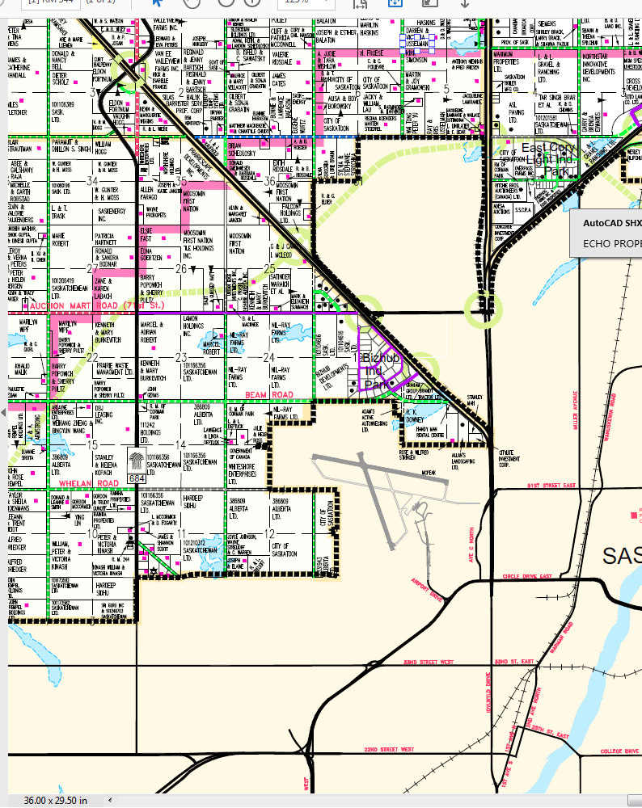
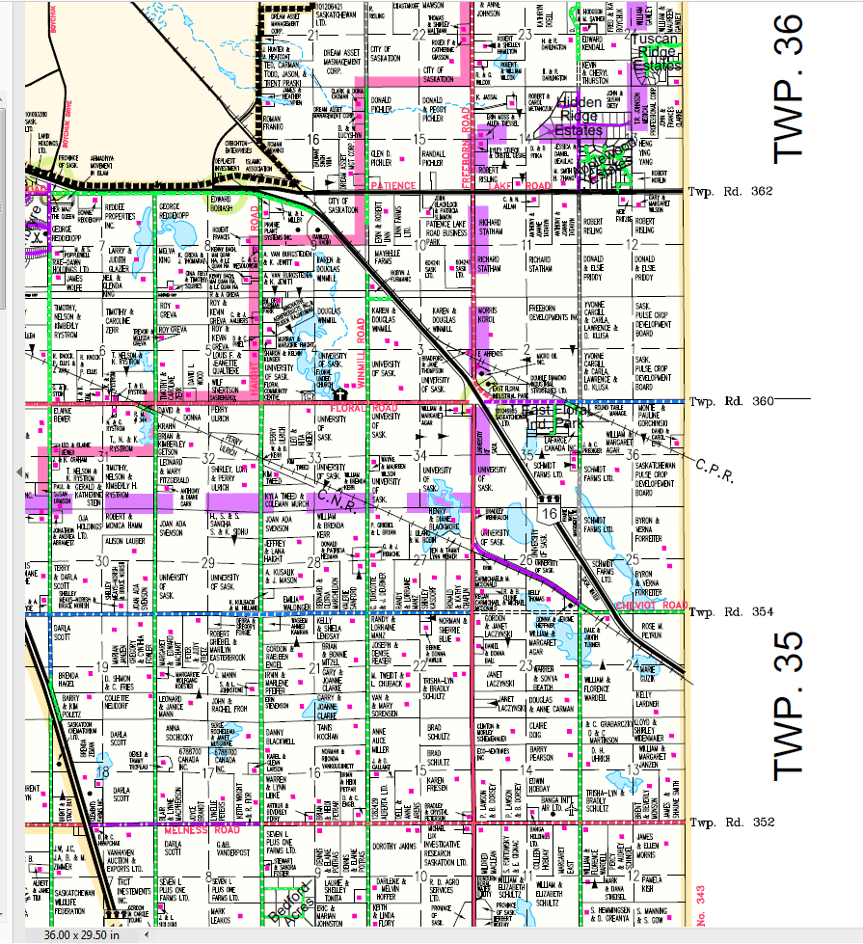
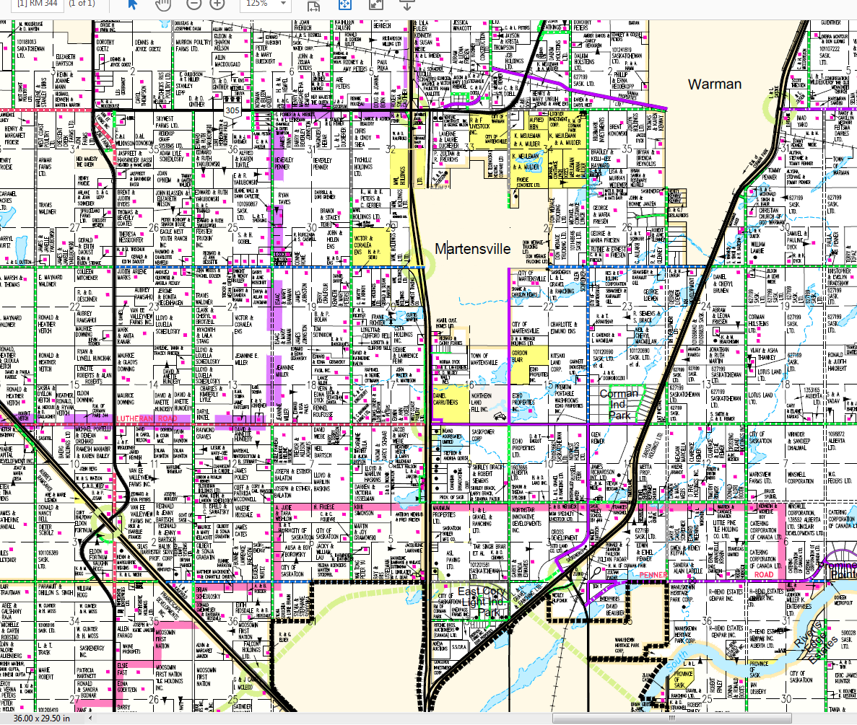
Area 2
Area 3
Area 1
Notes:
the Highway No. 11/12 corridor towards North Corman Industrial area up to Warman & M’ville;
The Highway No. 16 W corridor including BizHub/Yellowhead/Korpan Industrial areas; and
The East Floral Industrial area on Highway No. 16 east near Floral Road.

Slide 46
Drainage Study
Council direction to undertake a drainage study of :
Highway No. 11/12 corridor/North Corman Industrial area;
BizHub/Yellowhead/Korpan Industrial area; and
East Floral Industrial area
The intent of the drainage study is to:
identify existing drainage issues and catchment areas;
assess the impact of future development;
recommend drainage upgrades or improvements; and
provide policies for future development.
Funding for up to 80% of costs is being explored with the Federation of Canadian Municipalities (FCM)
A Request for Proposals is being prepared; the project will kick off in early 2018
Notes:
The intent of the drainage study is to
identify existing drainage issues and catchment areas,
assess the impact of future development,
recommend drainage upgrades and
provide policies for future development.
The study will be used to inform future studies or drainage works needed by the R.M. or private developers. For example the study might confirm the location of needed culverts and the sizes needed to withstand flooding. Another outcome of the study would be to identify appropriate development regulations for drainage such as the appropriate size of a storm pond used in the site design.
Funding with the Federation of Canadian Municipalities (FCM) is also been explored; FCM has confirmed that the project may be eligible for up to 80% of eligible costs. R.M. Administration is in the process of applying for this funding and releasing a request for proposals to begin the project in 2018.

Slide 47
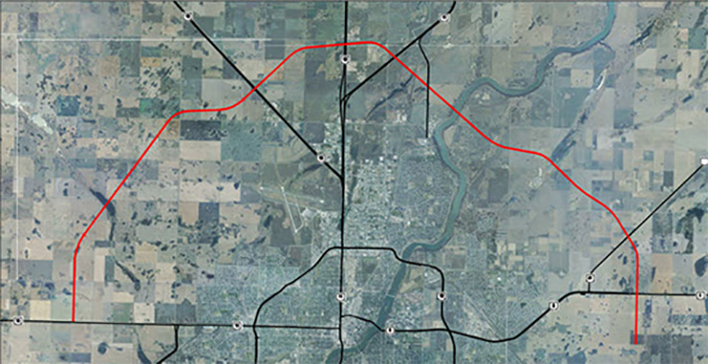
Perimeter Highway/
Saskatoon Freeway
www.saskatchewan.ca/saskatoon-freeway
Notes:
Moving onto a transportation project I’ve spoke about over the past couple years, the Ministry of Highways & Infrastructure has been undertaking work on setting the route for the Saskatoon Freeway, previously known as Perimeter Highway.
This map shows the northern portion of the route in red which was validated in 2014. Additional interchange design work and roadway details need to be done in the future by the province but generally the route is set in the north.

Slide 48
Notes:
However, MHI raised concerns with the south part of the route in 2014. They began a General Location study of the Saskatoon Freeway south east and west of Saskatoon.
Part of the review looked at setting new routes in the areas shown with the green lines.
This general location study also determined the need for a southwest connection of the Freeway between Highways No. 11 and No. 219 and across the river to Highway No. 7. In 2015 MHI concluded that a SW connection through the area with the yellow arrow and light yellow hatch was not needed and this area was removed from the study.
The project was not completed in 2016 as expected due to changes within provincial government.

Slide 49
Highway
No. 14
PCS Cory
West Alignments
Highway
No. 7
Notes:
In May 2017 updated information on the preferred alignments was shared on the MHI website. Landowners and other stakeholders who were impacted were contacted directly by MHI.
This map shows the proposed alignment out west near the PCS Cory mine and Highway No. 7. The preferred option is shown in red, with two other options shown in white.

Slide 50
South East Alignments
City of Saskatoon
Grasswood Junction
Highway No. 16
Highway No. 11
Notes:
This map shows the proposed alignment in the southeast from Highway No. 11/Grasswood Junction east towards Highway No. 16 then moving up towards 8th Street/Highway No. 5.
The preferred option is shown in red, with two other options shown in white.
The province will be finalizing this study by the end of the year. No construction timelines for the Saskatoon Freeway have been set and land acquisition won’t occur for some time. However the R.M. intends to work with the Ministry to finalize some of the detailed design work so we can proceed forward with land use planning and development in the area.

Slide 51







P4G Regional Plan
What is P4G?
Stands for Saskatoon North Partnership for Growth
Political and administrative collaborative formed in 2014
Hired consultant to complete Regional Plan
Quick Facts
4 urban and 1 rural municipality; includes representative from SREDA
Includes 11 First Nations land holdings
Some of the fastest growing municipalities in Canada
Anticipated regional population of over 500,000 in next 20 years
Regional Plan ‘endorsed in principle’ in fall 2017
Notes:
Lastly I want to talk about P4G or Saskatoon North Partnership For Growth. This group includes political and administrative representation from Corman Park, Saskatoon, Warman, Martensville, Osler as well as advisory representation from the Saskatoon Regional Economic Development Authority.
The P4G hired a project manager in 2013 and an independent consultant, O2 Planning + Design in October 2014 to complete the Regional Plan.
In May 2017, the political P4G Regional Oversight Committee endorsed the draft Regional Plan for public and municipal review. A final public presentation from the consultants was made on June 27, 2017.
This fall the P4G Regional Plan was ‘endorsed in principle’ by all of the municipalities.

Slide 52
P4G Future Land
Use Map
Project Website:
www.partnershipforgrowth.ca
Notes:
The map on the screen shows the P4G future land use map. The yellow colours show rural and urban residential areas and the purple colours show rural and urban commercial/industrial areas. The dark green is a green network study area and the lighter green area is agricultural. The grey areas show current urban boundaries.
As part of the proposed P4G Regional Plan a new Planning District is envisioned to be created. This will include expanded Planning District boundaries as well as an expanded 13 member District Planning Commission.
In order to create the new Planning District, a new P4G Official Community Plan and P4G Zoning Bylaw must be drafted and given provincial approval. This is expected to take place in late 2018. Additional public hearings, including the consideration for a joint public hearing between the five municipal Councils, will take place at that time. Initial stages of drafting the necessary Agreement and P4G Zoning Bylaw have begun; more information on the Zoning Bylaw project will be provided in the coming months through the R.M. website and communications.
Since this official approval of the new P4G District will continue into late 2018, getting endorsement in principle of this Plan was an important step. This allows us to file the draft documents with the province so development proposals in the region can begin to be evaluated, many of which are supported by P4G. This endorsement will also allow the R.M. to proceed with bylaw amendments to current policies to align with the P4G Regional Plan. For example Council is currently considering a bylaw to expand 5 per ¼ residential densities into the P4G study area to match agricultural areas.
There are likely many questions on P4G or other planning issues and I might not get to them all tonight, so please come in or call the RM office to talk to one of my staff. We don’t mind talking to you about the options available on your property. You can also visit the RM or P4G website for more information.
With that I would like to turn it over to our Chief of Police. Thank you

Slide 53
Corman Park Police Service
John Garnet
Police Chief

Slide 54
Corman Park Police Service Report January 1 to September 30, 2017
Staff of 5 full time and 2 part-time members and a full time executive assistant
Have responded to over 900 occurrences and issued +/- 3000 traffic related tickets
Notes:
Staff change from to more full time – increase of one FT position over this year and next . Greater emphasis on protection of people and infrastructure through bringing in HTC trained.

Slide 55
Corman Park Police Service Mandate
Mandate under the Saskatchewan Police Act
Responsibility for Provincial Statues and Municipal Bylaws as well non-injury accidents and criminal offences found in progress
Jurisdiction is the R.M. of Corman Park
However CPPS has jurisdiction in the entire Province when assisting an outside agency such as RCMP
Work closely with the RCMP, Saskatoon Police and other agencies to enhance the safety and security of the R.M.
Notes:
Mandate has been the same since the inception of CPPS. Mandate could be modified and changed if required – depends on needs of RM

Slide 56
Corman Park Police Occurrences
72 Litter Control Act
72 Dog complaints
47 Stray Animal Act
51 Fires/fire complaints
5 False alarms
10 Noise related complaints
102 Suspicious/misc. complaints
170 Assist general public calls
124 Assist outside agency calls
4 Incidents of use of force
10 Complaints under the Wildlife Act
4 Complaints under The All-terrain Vehicles Act
10 Alcohol and Gaming complaints/charges
2 Firearm investigations
13 Found incidents of property
24 Assist RM calls
6 Nuisance abatement investigations
Notes:
Littering up from 49, dogs down from 75 last year but 5 dangerous dog complaints this year, fires up slightly, alarms down, Suspicious down slightly, AGP up 70, assist outside down from 300
Most things up except the assist outside agencies and assist RM

Slide 57
R.M. Duties and Bylaw Concerns
24 Assist R.M. calls:
Water issues, signage
Planning and Development
Public Works
Tax Assessment
Administrative assistance
6 Nuisance Abatement investigations
Notes:
One of the goals with NA is to get voluntary compliance. Court is very expensive

Slide 58
Traffic Related Occurrences
57 Motor vehicle collisions attended
57 Traffic related complaints
44 Abandoned vehicle complaints
2900+ Traffic tickets to date including charges under the Traffic Safety Act, Highways and Transportation Act, Vehicle Weights and Dimensions, VER, biggest change is in Overweight vehicle – about triple
Numerous vehicle seizures and drivers license suspensions.
Notes:
Accidents about double, traffic complaints up, tickets up. Most notably overweight's. Protection of infrastructure and protection of public. The need for enforcement increases as population and traffic increases through he RM

Slide 59
Summarizing CPPS
Criminal offences are to be turned over to the RCMP or other agency
CPPS have laid several criminal charges including drug and impaired driving charges and assisted with numerous stolen auto and property complaints
Occurrence numbers are about the same as last year.
Overall ticket numbers are higher for 2017
There have been no founded Police Act complaints against any CPPS member.
CPPS is within the 2017 budget.
Notes:
No complaints in three years. Emphasis on professionalism. In car video and audio.
Within budget this year. Net cost of policing has come down the last three years for the RM

Slide 60
Rural Crime Watch
Organized through the RCMP in cooperation with CPPS
You become eyes and ears
Protect yourself and your neighbors
Get current information
Reduce crime and make the RM safer

Slide 61
2017 Citizen of the Year Award
Presented by Reeve Judy Harwood
R.M. of Corman Park

Slide 62
Open Floor
Questions? Comments?
** We ask that all ratepayers be given a chance to speak prior to proceeding with a second round **

