Slide 1

R.M. of Corman Park No. 344 Annual General Meeting
October 10, 2018

Slide 2
Agenda
Call to Order
Introduction of Council & Staff
Nomination of Chair
Consideration of Agenda
2017 Annual General Meeting Record of Proceedings
Council Report – Reeve Judy Harwood
2018 Election Report – Adam Tittemore, Returning Officer
2018 Election Candidate Introductory Speeches
Administration Report – Adam Tittemore, Administrator
Public Works Report – Craig Habermehl, Director of Public Works
Planning Report – Rebecca Row, Director of Planning & Development
Corman Park Police Service – John Garnet, Chief of Police
2018 Citizen of the Year Award
Open Floor
Adjourn

Slide 3
Introductions R.M. of Corman Park Council & Staff

Slide 4
Nomination of Meeting Chairman

Slide 5
Consideration of Agenda

Slide 6
2017 Annual General Meeting Record of Proceedings

Slide 7
Council Report
Judy Harwood
Reeve
R.M. of Corman Park
Notes:
Good evening…thank yous

Slide 8
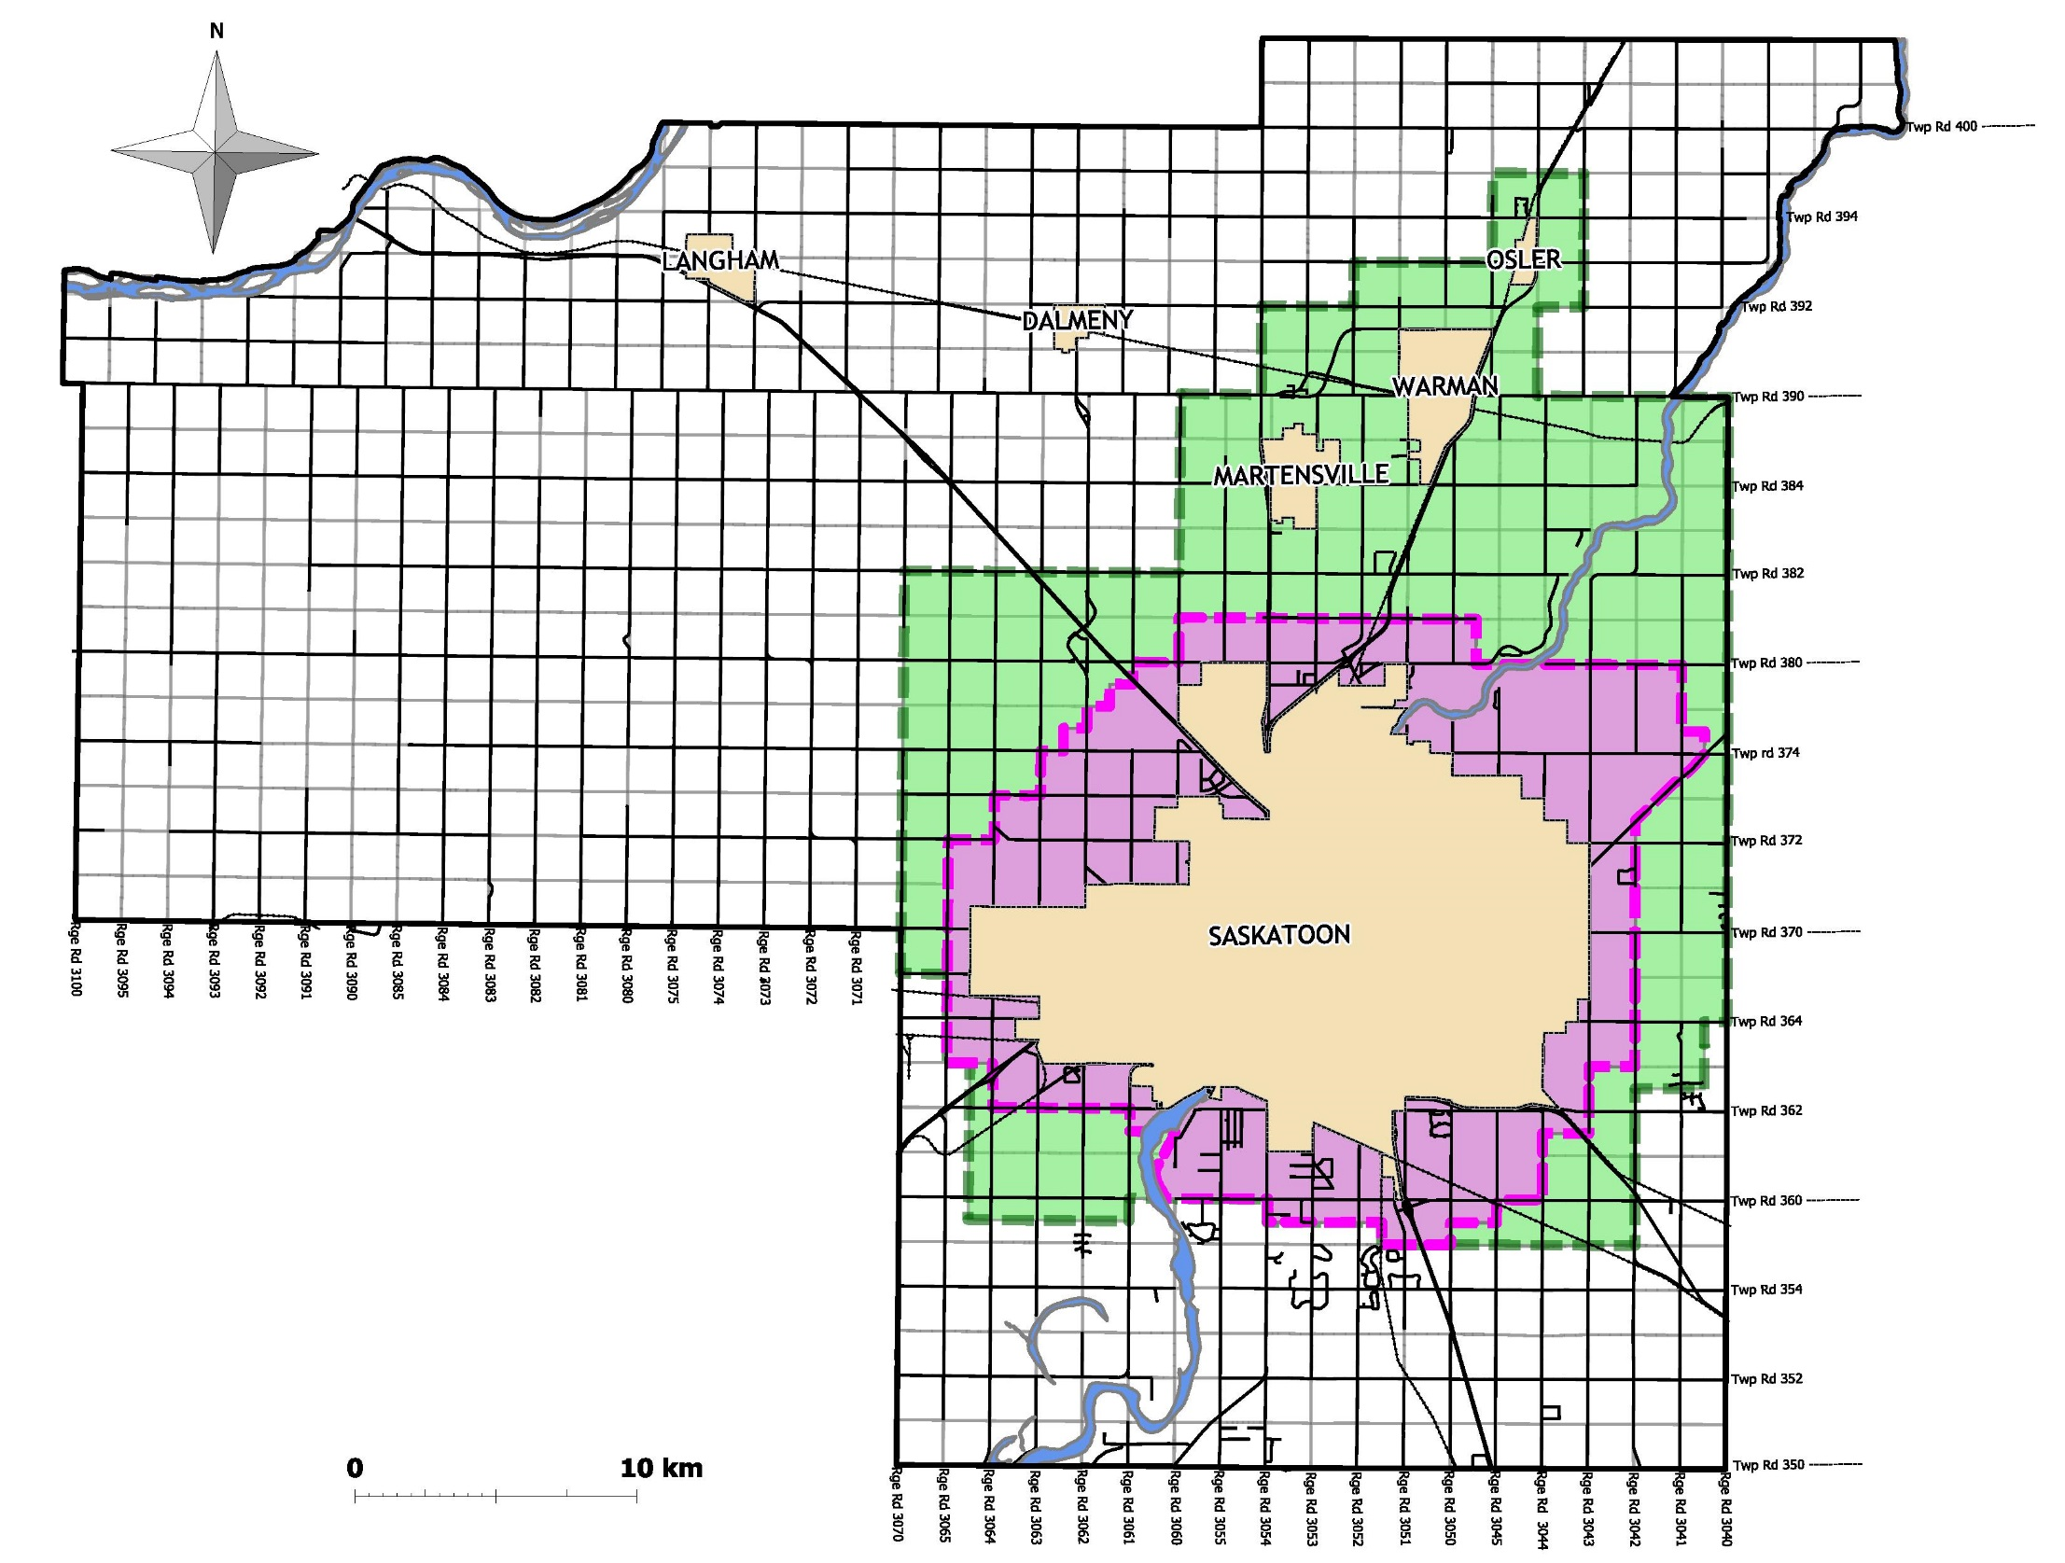
R.M. of Corman Park
No. 344
Notes:
As many of you know, the Rural Municipality of Corman Park was established in 1970 following the amalgamation of the three smaller rural municipalities of Cory, Warman and Park.
The R.M. covers an area of approximately 800 square miles, with a current population close to 9,000. These numbers make Corman Park the largest rural municipality in the province by population by double the margin of the next largest, and one of the biggest in terms of land mass.
All major highways leading to Saskatoon are within the R.M., in addition to over 1200 km of municipally maintained roadways
Corman Park prides itself on providing residents and visitors alike the highest possible level of service to work, live, and play.

Slide 9
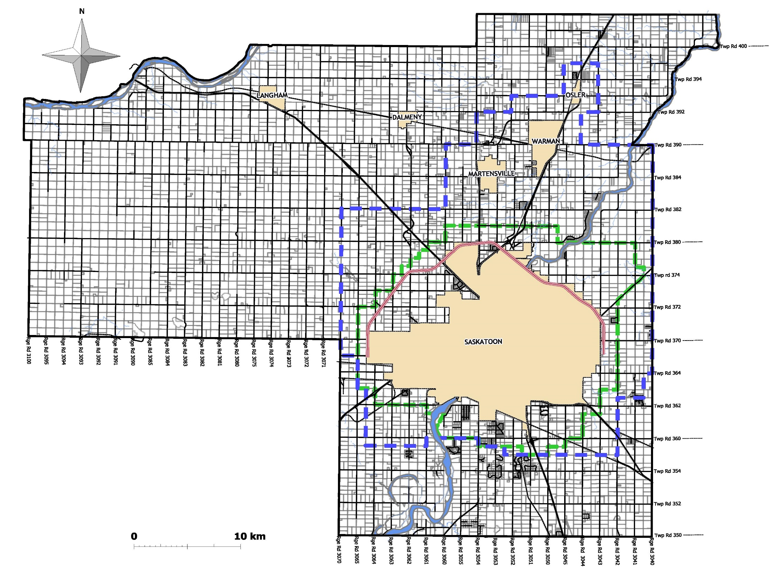
Commercial/Industrial
Five dedicated industrial parks in the R.M.
2 acre to 10 acre industrial lot sizes
Numerous parcels of major commercial highway corridor development
Value-added agricultural developments
Home Based Business opportunities
North
Corman
East Cory
Yellowhead
& BizHub
R.M. of Corman Park
No. 344
East Floral
Notes:
Now moving into what Corman Park has to offer.
Corman Park has 5 dedicated industrial parks, along with dedicated parcels of industrial lands located along major transportation corridors.

Slide 10
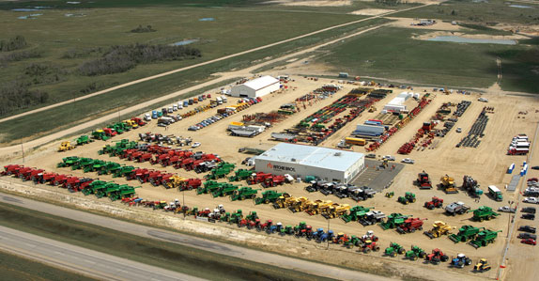
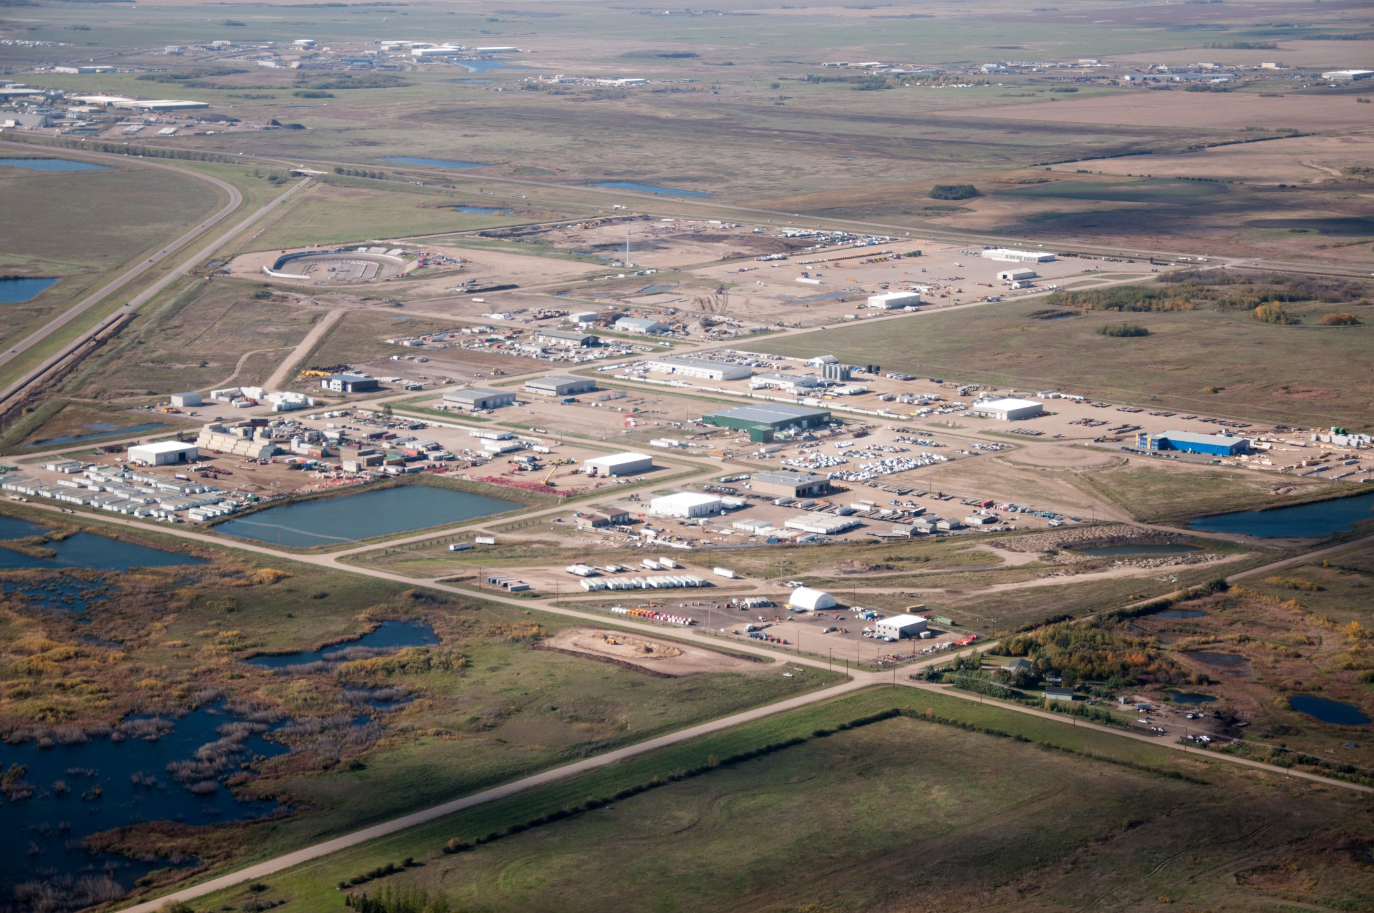
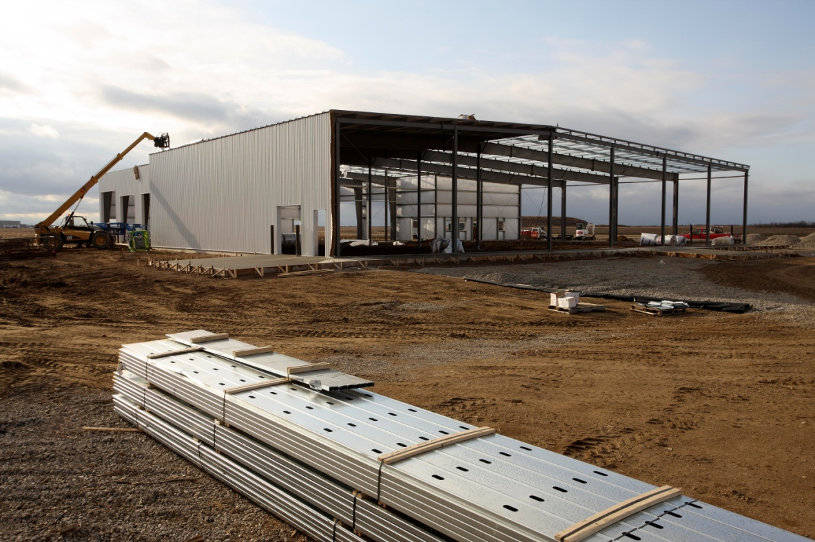
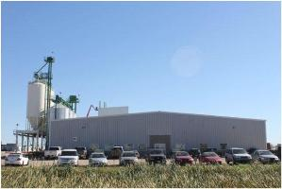
Notes:
We allow for industrial lots sized from 2 acres to 10 acres, or larger, and outside of dedicated industrial parks we also have commercial-industrial development along major transportation corridors.
Corman Park is also home to a wide variety of commercial enterprises, ranging from implement dealerships, and service industries to home based businesses.

Slide 11
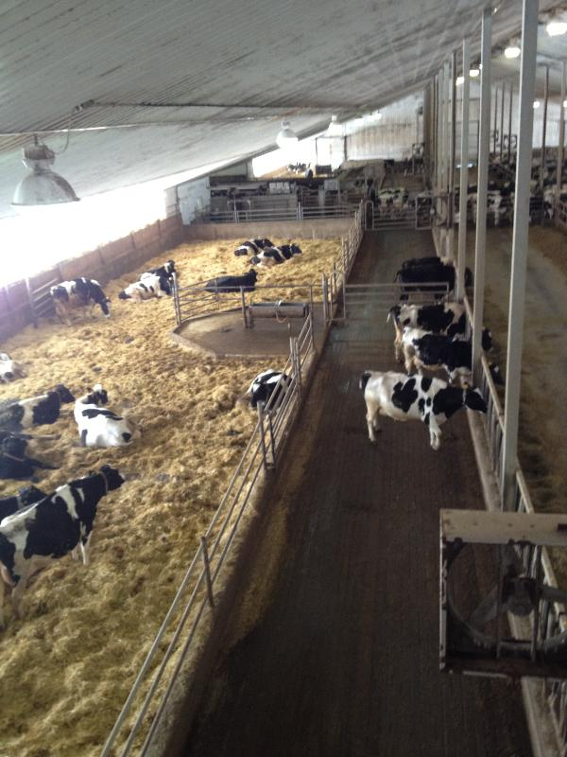
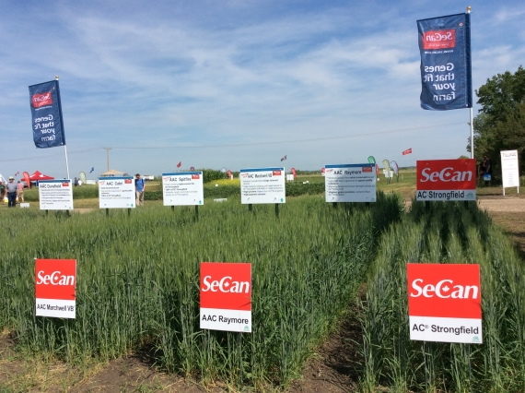

Notes:
Corman Park, particularly in the north and west portions of the R.M. is home to a booming agriculture and agriculture support service industry. This includes grain farming operations and intensive livestock operations of all types, with the R.M. being the location for the largest concentration of dairy operations in the province. In addition to this, the R.M. is home to an ever expanding number of farm-gate businesses.

Slide 12
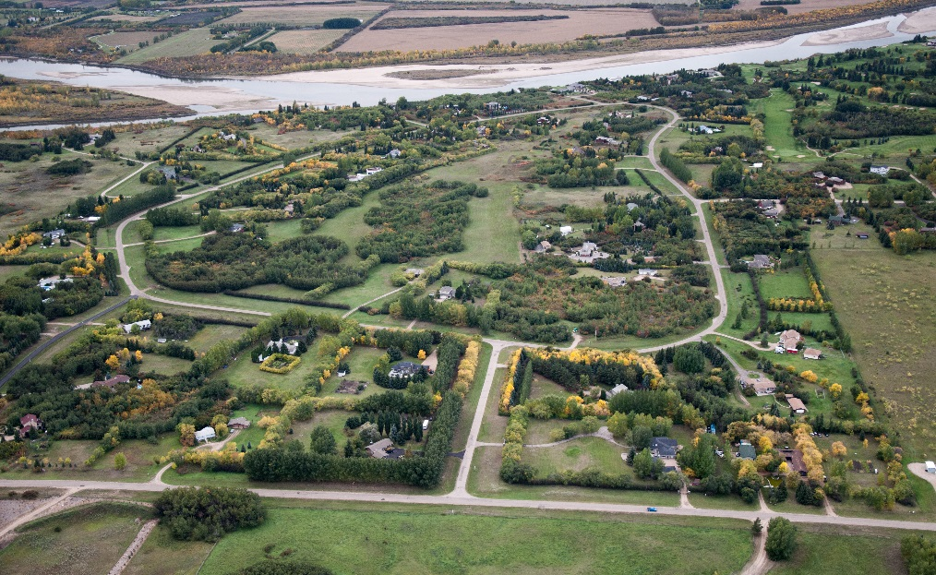
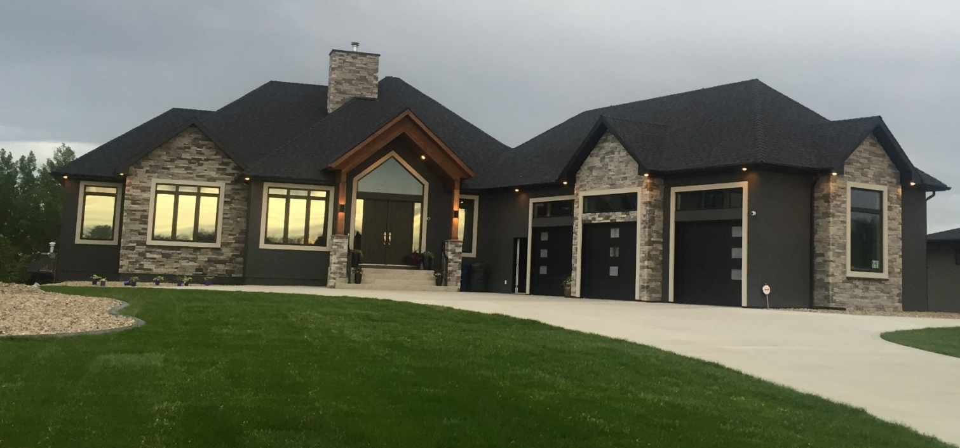
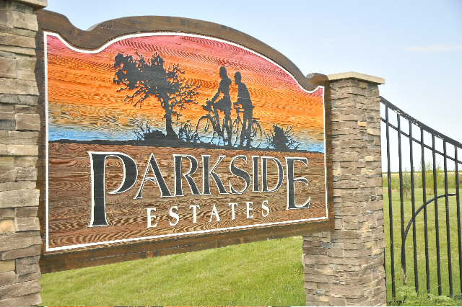
Rural Lifestyle Choices
Notes:
Corman Park allows for the development of a variety of residential options, including large acreage agricultural subdivisions, along with denser country residential developments.
Demand continues for development, including proposals such as the recently publicized “Solaire” development that would focus on solar power and progressive neighborhood design.

Slide 13

R.M. of Corman Park
No. 344
Notes:
We have over 30 residential subdivisions, including our 11 hamlets, within Corman Park with lots sizes ranging from ½ acre to over 10 acres. Some of our current subdivisions include Greenbryre Estates, Saddle Ridge, Prominence Point and Grasswood Estates.

Slide 14
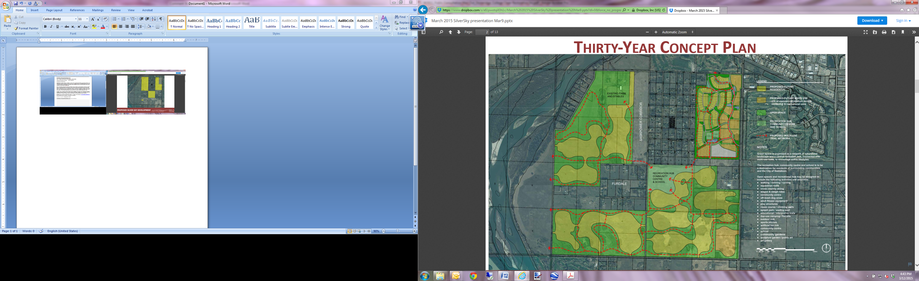
Notes:
I want to take a moment to recognize some examples of innovative development that is occurring and proposed for Corman Park.
A proposal submitted to Council for consideration is for Silver Sky which surrounds the Furdale and Birchwood Heights subdivisions, west of Highway No. 219. Silver Sky is proposed as a large multi-use residential area that would include commercial and recreational support services, and consist of over 1,600 residential lots built over a number of long term phases. This proposed development is currently in the initial planning, design and servicing investigation stage by the developer.

Slide 15
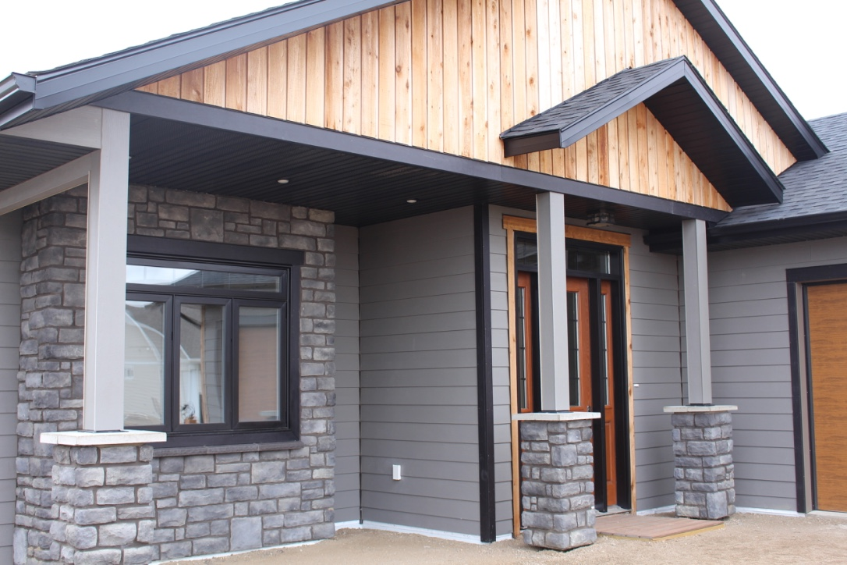
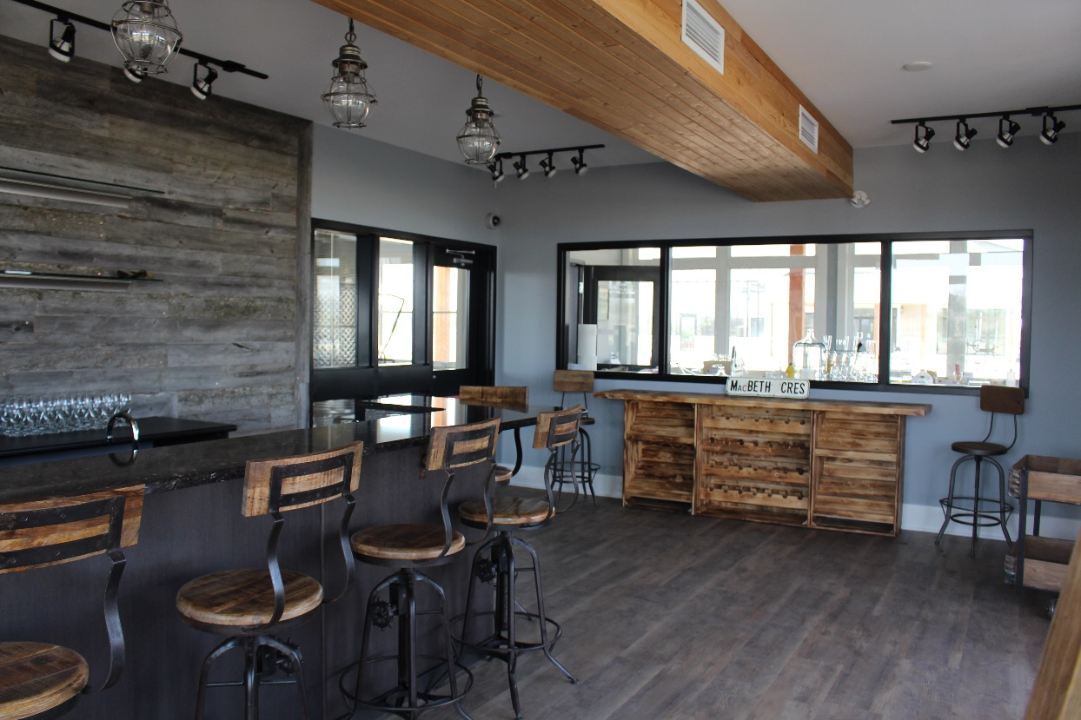
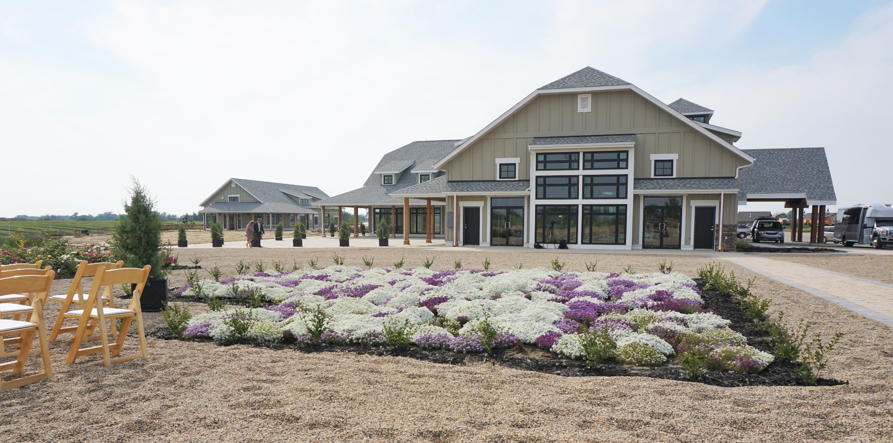
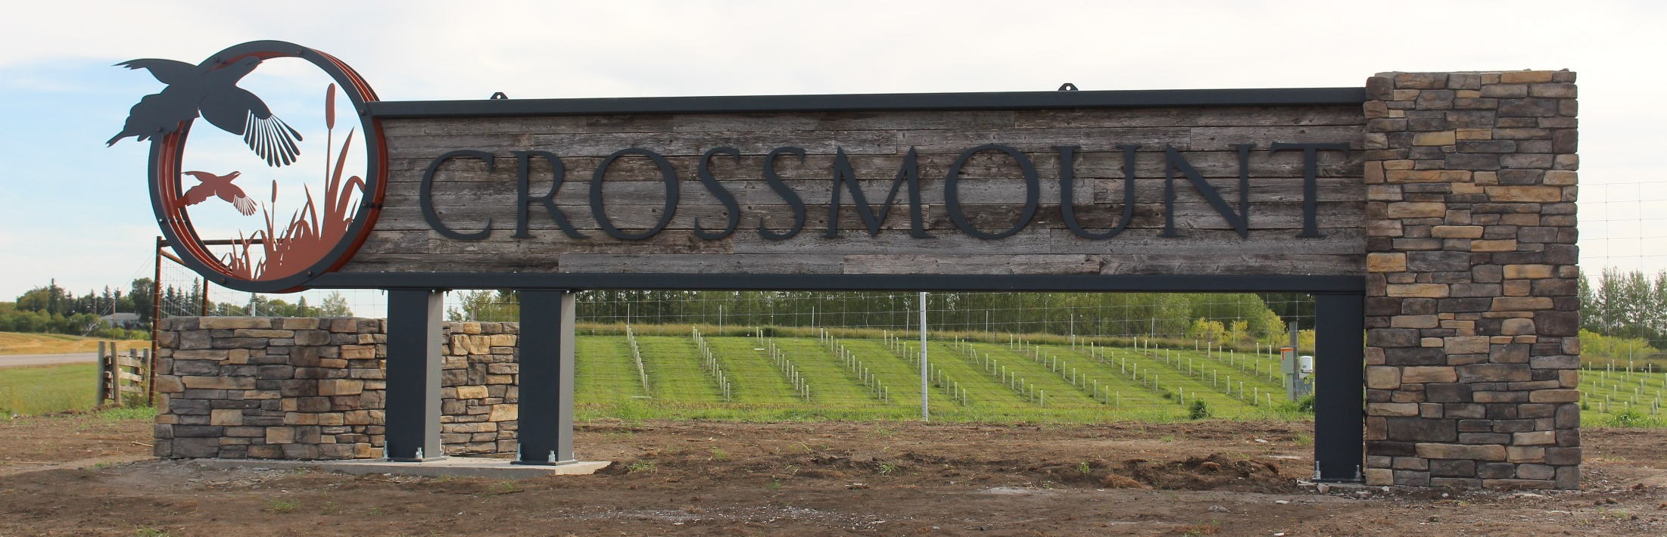
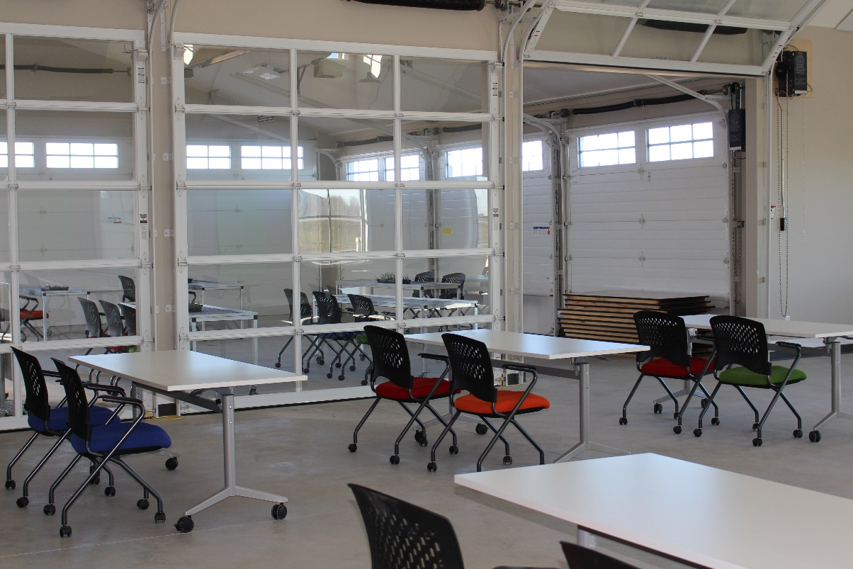
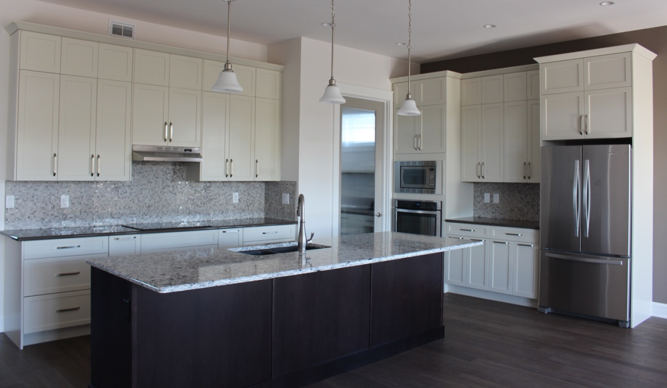
The Village at Crossmount: Event Centre
Crossmount
Cider Co.
Arts Barn
Notes:
Another innovative development is the Village at Crossmount, which is an aging in place facility being built on 600 acres south of Saskatoon off of Highway No. 219.
R.M. Council is excited to see developers come forward with new, ground-breaking ideas for people to live in Corman Park!

Slide 16
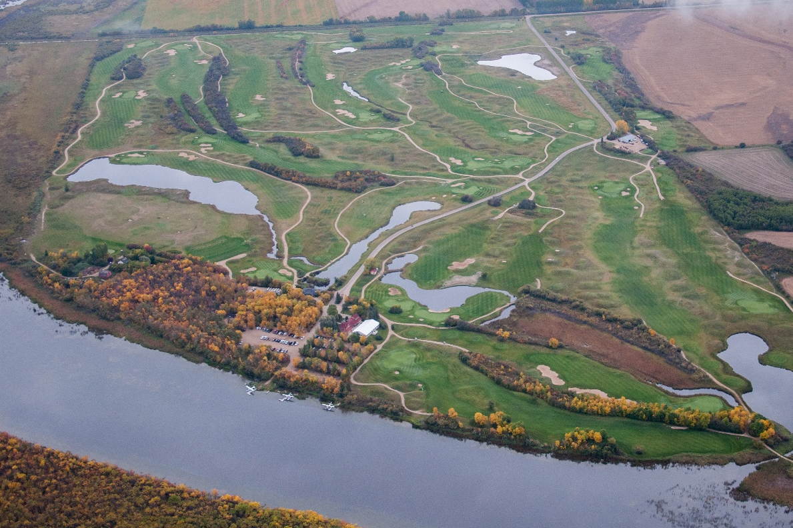
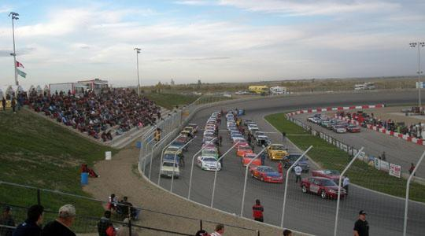
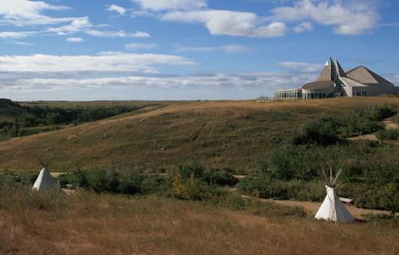
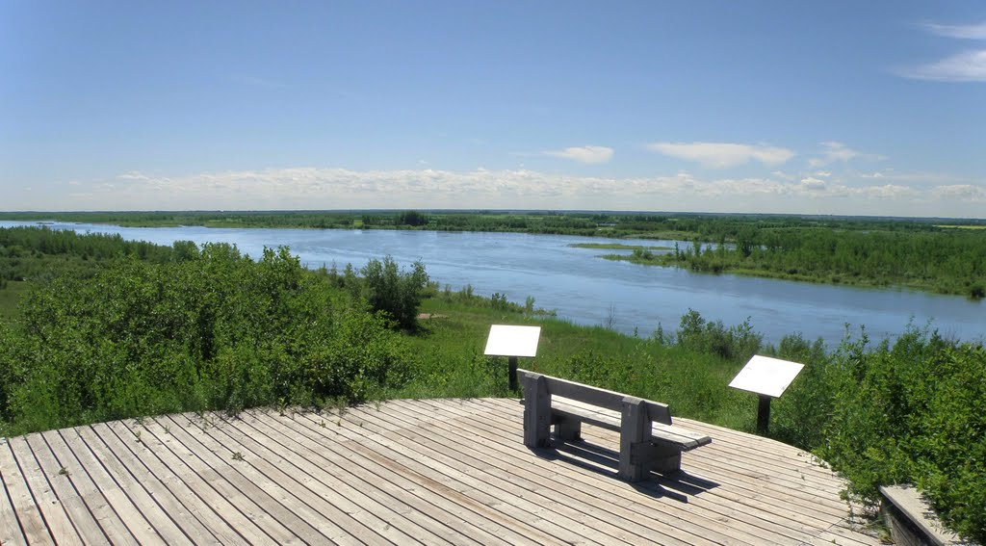
Moon Lake Golf Course
Wyant Group Raceway
Wanuskewin Heritage Park
Cranberry Flats Conservation Area
Notes:
Corman Park is home to all manner of services that make it the ideal place to enjoy a little bit of the country experience, including but not limited to 4 golf courses, 2 race tracks, Wanuskewin Heritage Park, Cranberry Flats & Beaver Creek recreational sites, restaurants, sporting arenas, hotels, riding stables, vacation farms and numerous other facilities.

Slide 17
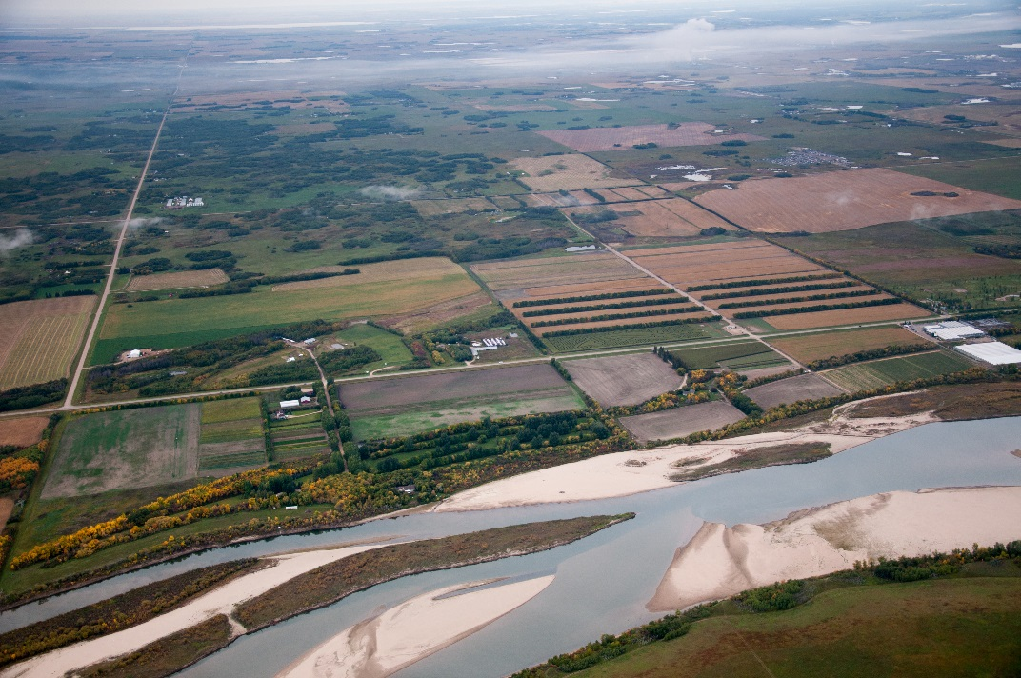
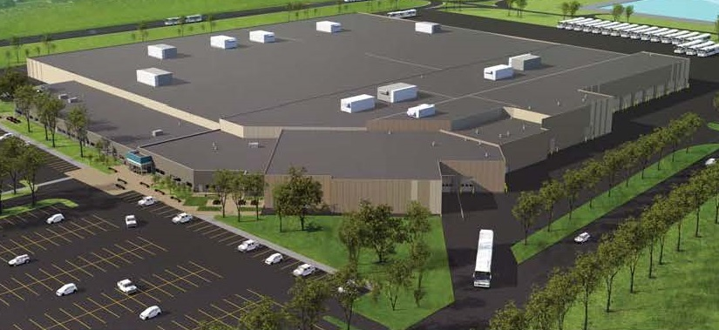
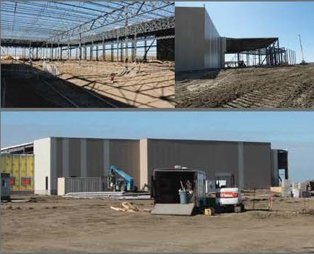
City of Saskatoon’s Civic Operations Centre
Valley Road Agri-Tourism Area

Slide 19
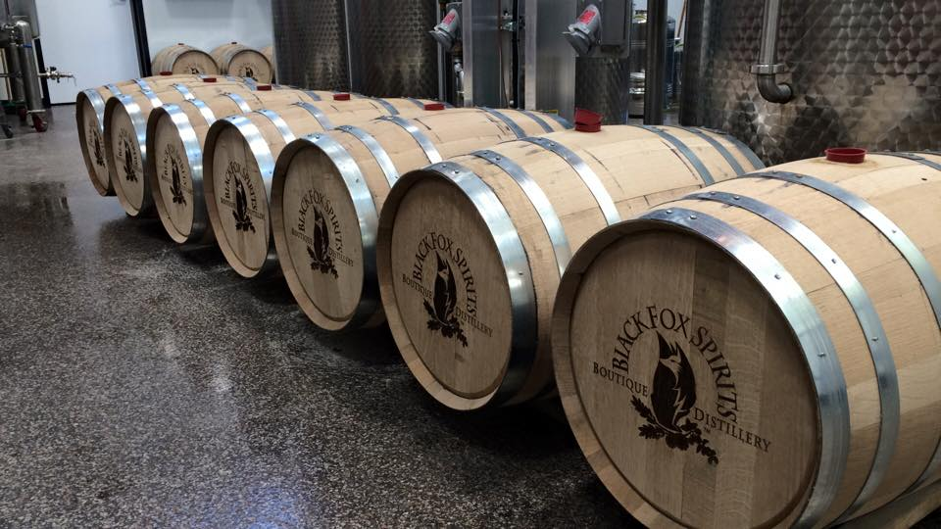

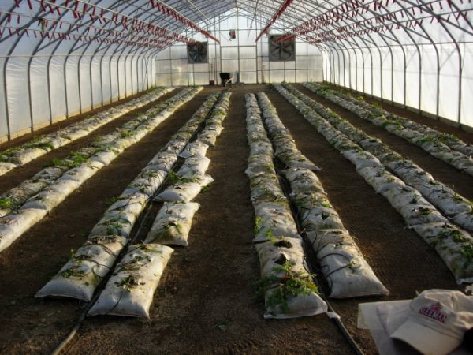
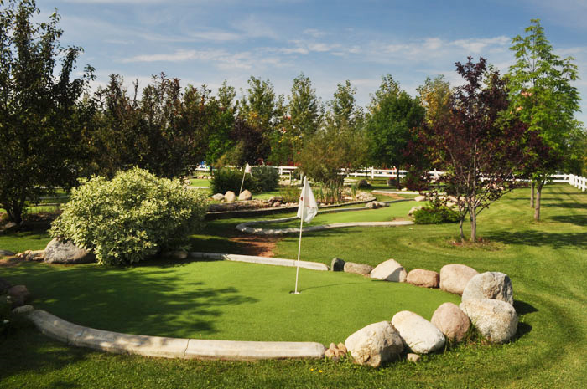
Notes:
Driving out Valley Road you will encounter a number of businesses including a dog kennel, Tuff Turf sod farm, newly opened Black Fox Spirits distillery, numerous greenhouses and market gardens, a mini golf/pitch and putt, Strawberry Ranch, corn maze, driving range, and 9 hole par 3 golf course.

Slide 20
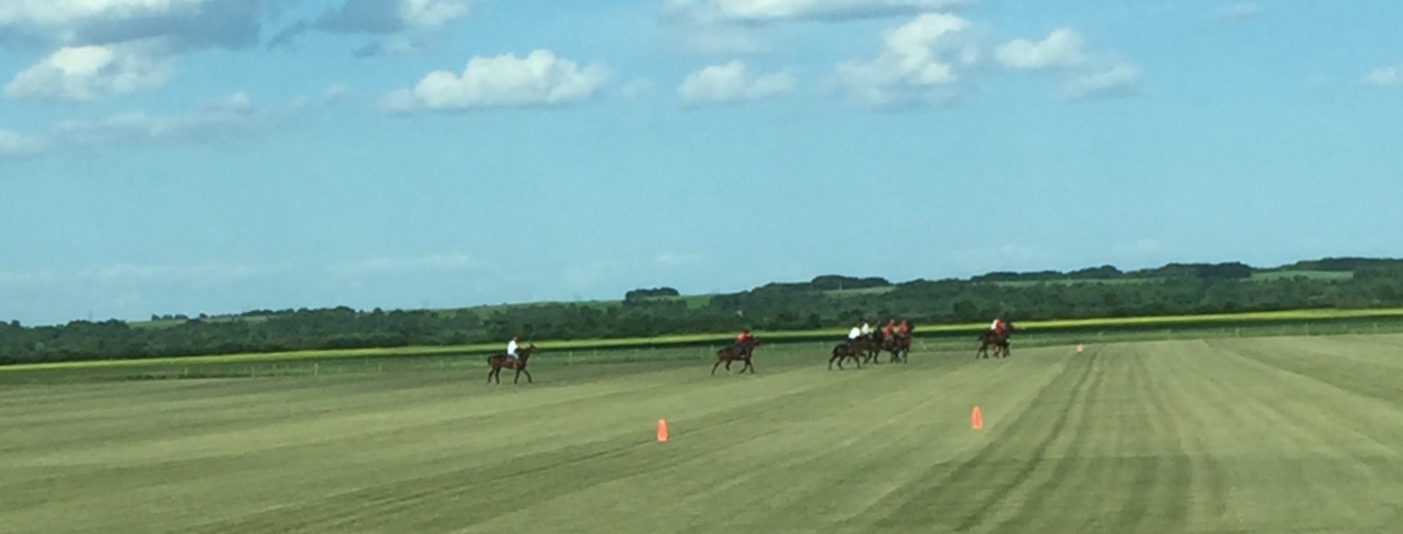
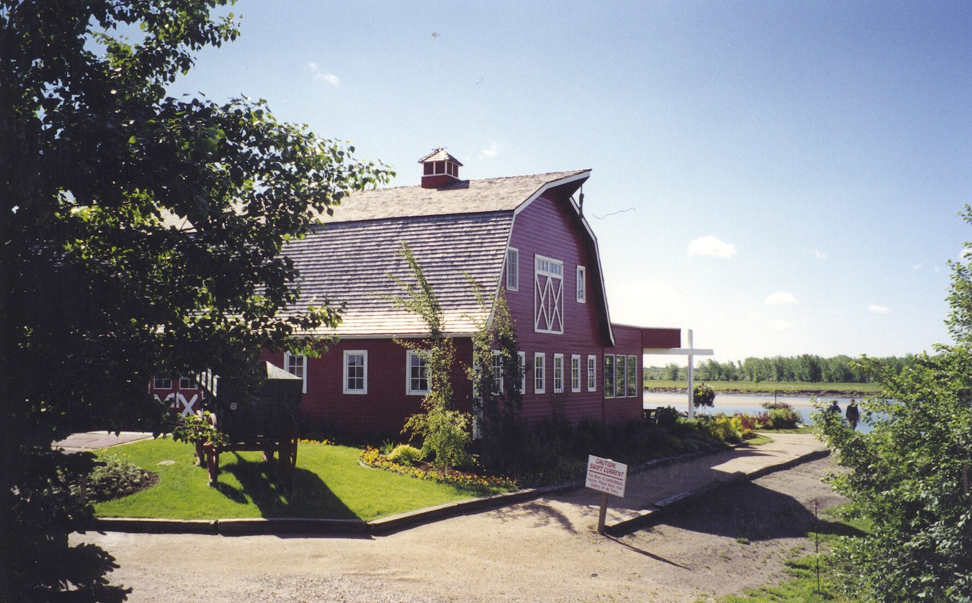
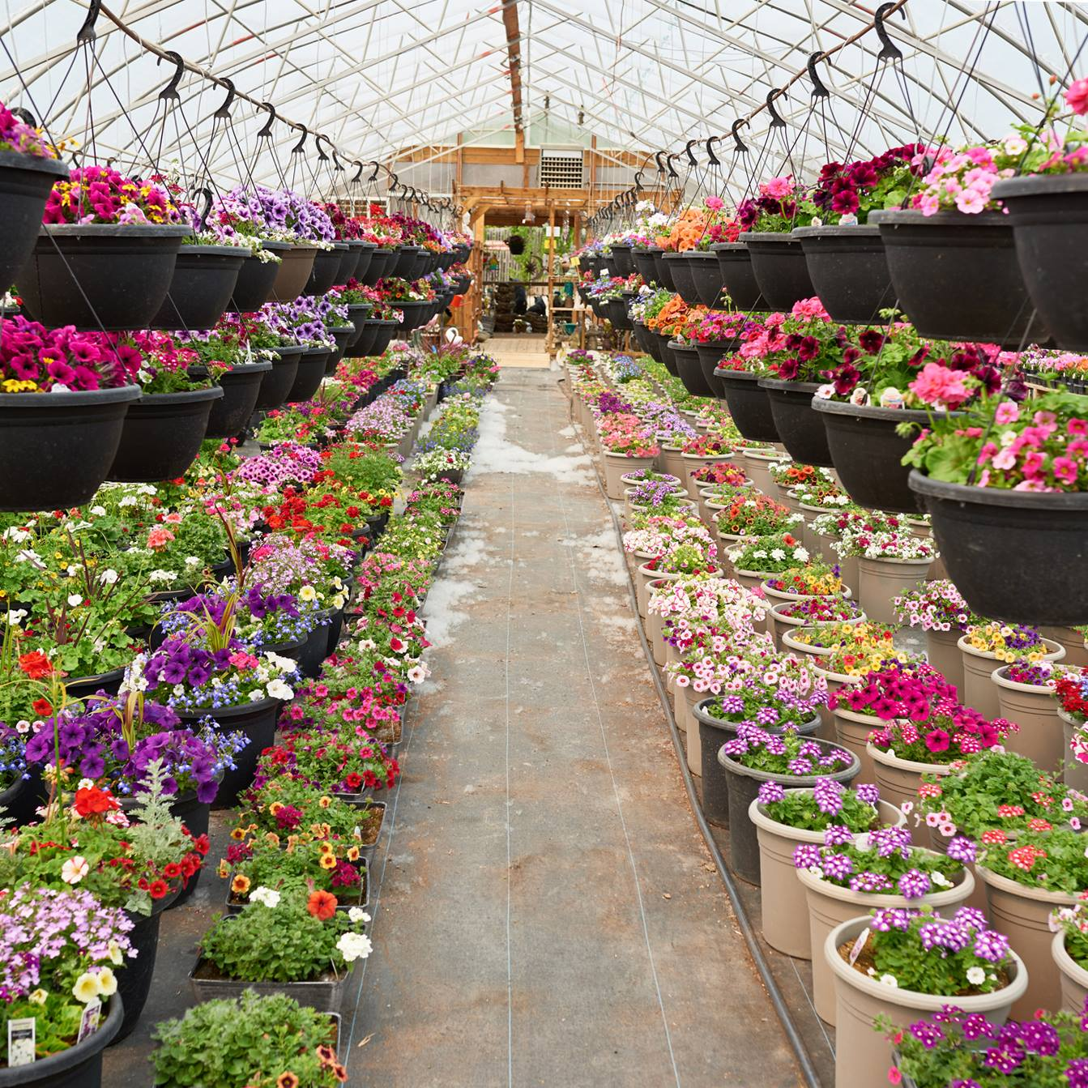
Notes:
Near the southern edge along the bend in the river is the Moon Lake Berry U Pick, Berry Barn, Moon Lake Golf Course and Lakeshore Tree Farm.
Please be sure to take your friends and family out to this amazing amenity area in Corman Park!

Slide 21
A Year in Review
Notes:
Year in Review text

Slide 22
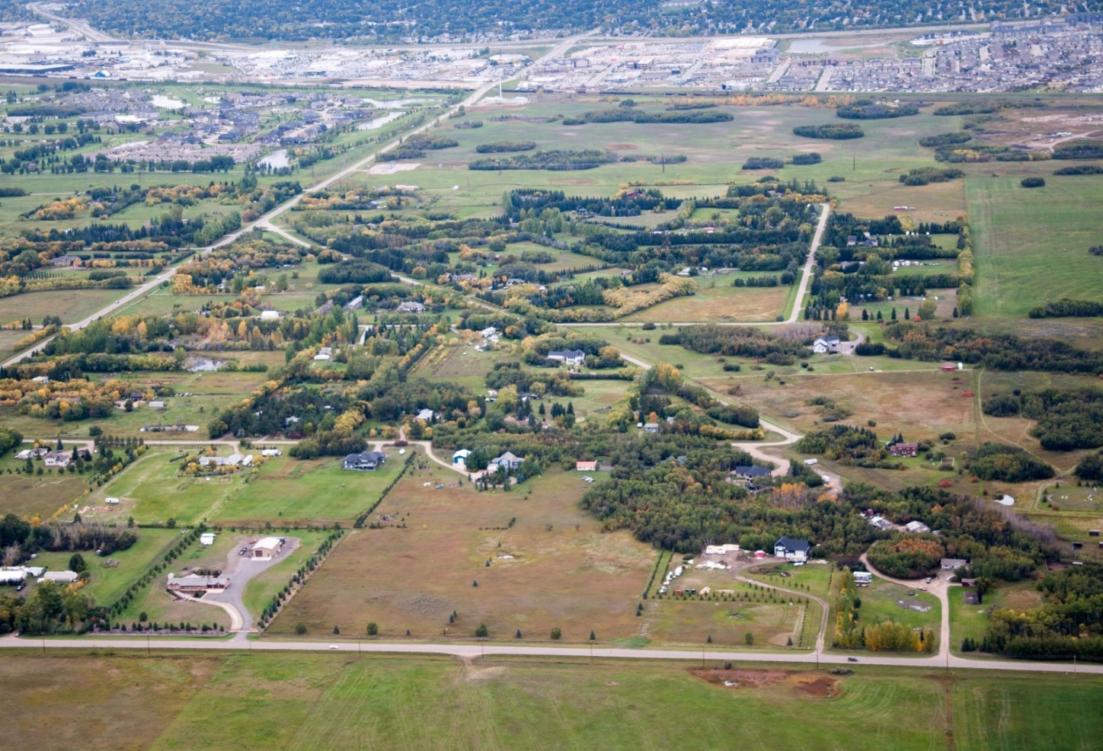
Thank you!
Please visit www.rmcormanpark.ca
Notes:
Corman Park prides itself in being “Open for Business”, with our Council allowing for development as the market dictates, while still ensuring that development is completed in a timely, sustainable manner. We work diligently to ensure that all land use documents, including zoning bylaws, future land use maps, and other policies are up to date and allow for the most efficient uses of land and for investors to feel confident moving into the municipality.
I am very proud to be Reeve, and represent the ratepayers and residents of Corman Park for another term as we continue to grow and prosper as a leader within western Canada. Thank you!

Slide 23
Election Report
Adam Tittemore
Returning Officer

Slide 24

Municipal Elections 2018
Councillors Michelle Chuhaniuk (2), Bas Froese-Kooijenga (6), and Wendy Trask (8) have been acclaimed.
A vote will be held for the election of Councillor for Division 4 between:
Mr. David Greenwood
Mr. Calvin Weber

Slide 25
Municipal Elections 2018
Election Day is Wednesday, October 24, 2018
Polls are open from 9:00 a.m. to 8:00 p.m.
R.M. Office – 111 Pinehouse Drive
Old 33rd St Shop
Merrill School

Slide 26

Advance Poll
Friday, October 19, 2018
9:00 a.m. to 8:00 p.m.
R.M. Office – 111 Pinehouse Drive, Saskatoon
Mail in balloting system available prior to October 24

Slide 27
Voter Eligibility
A person is qualified to be registered as a voter in a rural municipality if he or she on the day of the election:
is 18 years old;
is a Canadian citizen;
has not already voted in the election; and
immediately preceding the day of the election meets at least one of the following criteria:
a) has resided in the rural municipality for at least the last 3 consecutive months;
b) is the registered owner of land in the rural municipality or the purchaser of land in the rural municipality under a bona fide agreement for sale;

Slide 28
Voter Eligibility
c) is assessed as an occupant of any land in the rural municipality pursuant to a lease, licence, permit or contract in agreement with the registered owner;
d) is assessed with respect to an improvement in the rural municipality;
e) is the holder of a permit in the rural municipality with respect to a trailer or mobile home;
f) is the spouse of a person described in clause (b), (c), (d) or (e);
g) is the chief executive officer of a duly incorporated co-operative, corporation or religious association that is assessed on the last revised assessment roll with respect to property in the rural municipality that is not exempt from taxation.

Slide 29
Voter Identification All voters must provide identification to be eligible to vote. The purpose of the voter identification is to provide proof of identity and to establish residency. Government-issued photo identification is your best option but there are other alternatives available to you.

Slide 30

Candidate Speeches
Each candidate will have up to five minutes to speak about themselves and their platforms

Slide 31
Administration
Adam Tittemore
Administrator

Slide 32
Overview
Ensure municipal operations are completed in an efficient manner
Ensure Bylaws and resolutions of Council are implemented
Make recommendations to Council on legislative decisions
Long term planning

Slide 33
Departments
Administration
Finance, Taxes, Utilities, Assessment
Public Works
Roads, Utilities, Permitting, Drainage, Mapping, Mowing
Planning & Development
Zoning, Subdivisions, Planning, Permits, Enforcement
Protective Services
Traffic Fines, Enforce Municipal & Provincial Bylaws

Slide 34
2017 Financial Information
Operational Revenues $17.05M
Operational Expenditures $14.50M
Operational Surplus $2.55M
Capital Investment $3.87M
Valley Road Phase 2 Project
Fibre Optic Upgrade
3 New Graders
Notes:
The RM of Corman Park is committed to re-investing dollars in the community and providing a high level of service to its ratepayers. Investments are being made in renewing our capital equipment and infrastructure.
Valley Road Phase 2 (900K)
Casa Rio & Ceda Villa Fibre Optic Upgrades (390K)
3 New Graders (1 Million)

Slide 35

2018 Budget Allocation
Category | Amount (Millions) | Percent
School Taxes | $12.00 | 37%
Public Works | $8.30 | 26%
Capital Investment | $6.50 | 20%
Protective Services | $2.30 | 7%
Planning | $1.30 | 4%
Administration | $1.20 | 4%
Environment | $0.30 | 1%
Recreation | $0.20 | 1%
Notes:
The total operations budget is approximately $14 Million.
The RM also collects approximately $12M in education property taxes which is distributed to the Prairie Spirit and St. Paul’s School Divisions.

Slide 36

2018 Budget Highlights
Net Capital Investment of $6.5 Million includes:
2 Miles of Baker Road (1.7M)
1 Mile of Neuhorst Road (1.4M)
3 New Graders (935K)
Phase 3 of Valley Road Project (850K)
Notes:
$2.63M Increase in Capital Investment from 2017

Slide 37

Assessment & Taxation
Assessment
Mill Rate
Appeal
TIPPS Program
*Tax payments must be received by
December 31, 2018*
Notes:
- 2018 was a non-revaluation year for assessment, values for the majority of properties did not change
Uniform Mill Rate was 4.75
Mill Rate Factor for AG Increased from 1.30 to 1.40
- The Average Tax Increase was 3.26%
- RM had 69 Appeals in 2018, much lower then the 140 appeals received in 2017 revaluation year;
- Currently 332 applicants on TIPPS, convenient and easy method of payment; forms are available on our website

Slide 38

Community Funding
Saskatchewan Lotteries Funding
Community Facility Funding
Non-Profit Grant Program
SARM Scholarships

Slide 39

Long Term Planning
Notes:
Over the years administration and Council have made it a priority to improve the financial health of the RM. Reserves have increased from 2.82 Million to approximately 12.9 Million. These funds will assist the RM in achieving its long term goals.
Example: execution of 10 year capital plan

Slide 40
Long Term Planning Cont.
Strategically allocating funds for future projects
Continue growth of Reserve Funds
Identify Alternative Revenue Sources to alleviate pressure on Property Tax Levy
Notes:
Ex: Alternative revenue sources include provincial and federal grant programs (Canada Building Fund, Waste Water Initiative Program)

Slide 41

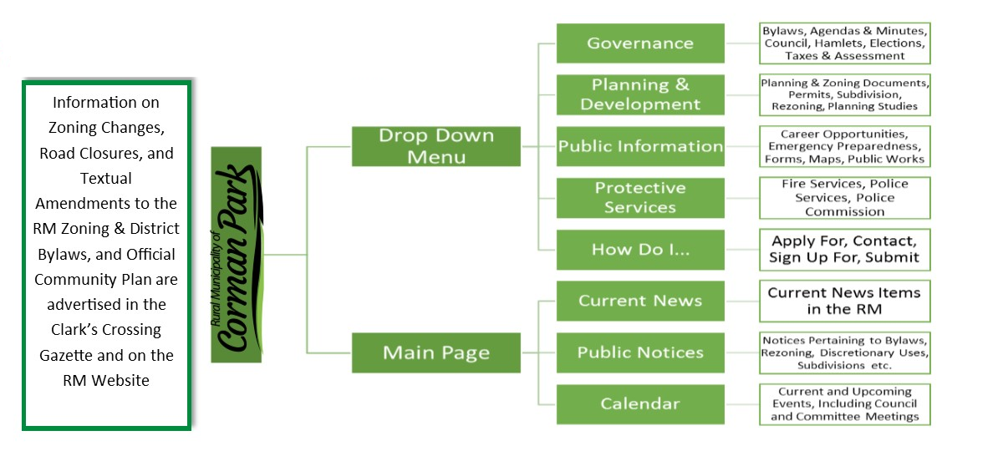
Where to find Information

Slide 42
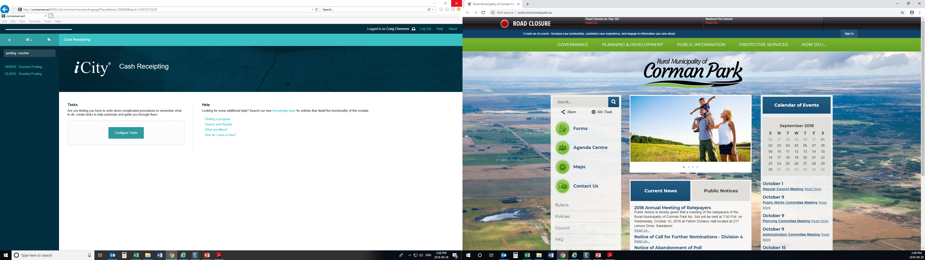
Website Navigation
Please visit at www.rmcormanpark.ca

Slide 43
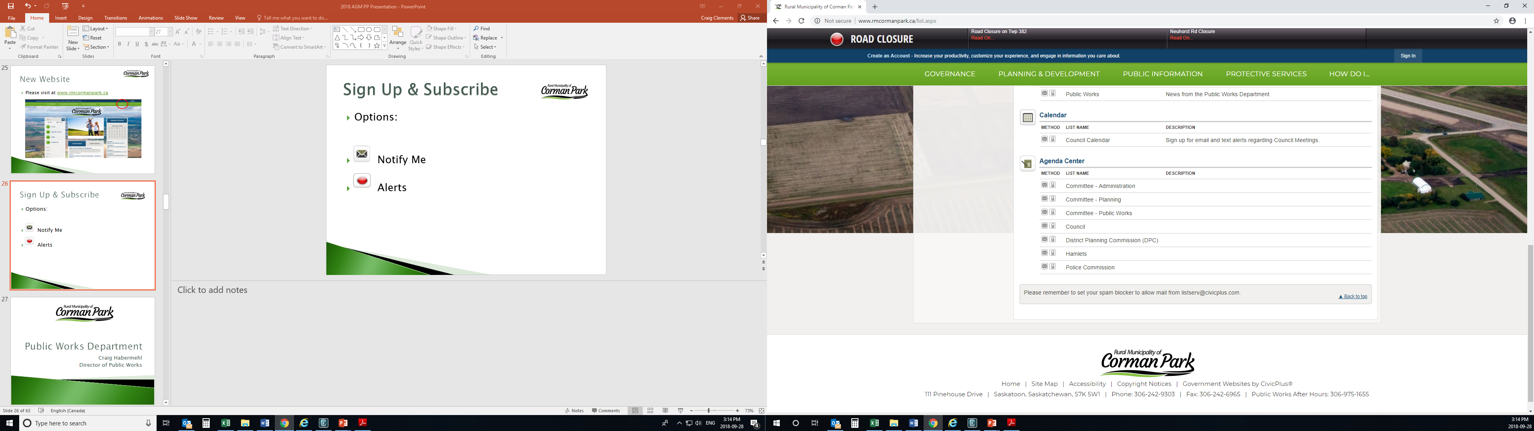

Sign Up & Subscribe
Options:

Slide 44
Public Works Department
Craig Habermehl
Director of Public Works

Slide 45
Overview
1,030 Miles of Roadway
138 miles of hard surface roads
892 miles of gravel roads
Notes:
Overview
There are a totoal of 1,030 Miles of Roadway within the RM
138 miles of these roads are hard surfaced (chip sealed or pavement)
The remaining 892 miles are gravel roads.

Slide 46
Road Maintenance
12 Grader zones following a 9 to 13 day rotation depending on weather
Crack Filling & Sealing
Preventative maintenance on hard surface roads
500 Tonnes of Asphalt Patching Completed
Notes:
Road Maintenance
There are 12 Grader zones following a 9 to 13 day rotation depending on weather
Crack Filling & Sealing
Preventative maintenance on hard surface roads
500 Tonnes of Asphalt Patching Completed
Levelling Courses done on section(s) of Blumenheim and Rge Rd 3041 south of Hidden Ridge Estates

Slide 47
Gravel Program
Three Year Rotation
42,000 yd3 of gravel applied in the 2018 gravel program
5,000 yd3 of gravel applied to road construction and additional projects
375 Miles of Road Received Gravel in 2018
Notes:
Gravel Program
Three Year Rotation
42,000 yd3 of gravel applied in the 2018 gravel program
5,000 yd3 of gravel applied to road construction and additional projects
375 Miles of Road Received Gravel in 2018

Slide 48
Gravel Road Construction
In House
3.5 Miles of road constructed
Contracted
4.7 Miles of road construction
Notes:
Gravel Road Construction
2018 was a strong construction season largely based on the dry weather.
In House
3.5 miles of road constructed
Contracted
4.7 miles of rock mulching done

Slide 49
Hard Surface Road Construction
In House
9.4 Miles of roads seal coated
Contracted
6.6 Miles of roads paved
3.3 Miles on Valley Road
1.0 Miles on Neuhorst Road
2.0 Miles on Baker Road
0.3 Miles on Melness Road
Notes:
Hard Surface Road Construction
Record year for work on hard surfaced roadways.
In House
9.4 miles of roads seal coated in 2018 an increase of 30% from 2017 (7.2 miles)
Contracted
6.6 Miles of roads resurfaced, nearly double from the 3.4 Miles of roads resurfaced in 2017
<>3.3 miles on Valley Road
<>1.0 miles on Rge Rd 3050 by Nuehorst
<>2.0 miles on Baker Road
<>0.3 miles on Melness Road

Slide 50
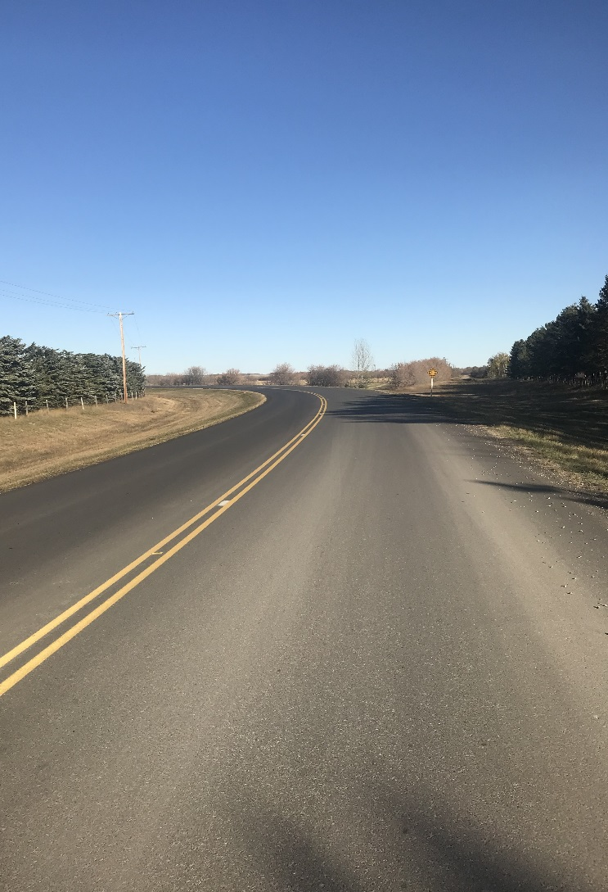
Valley Road Project
Notes:
This is the last phase of the Valley Road Project.
The project was completed in June of 2018

Slide 51
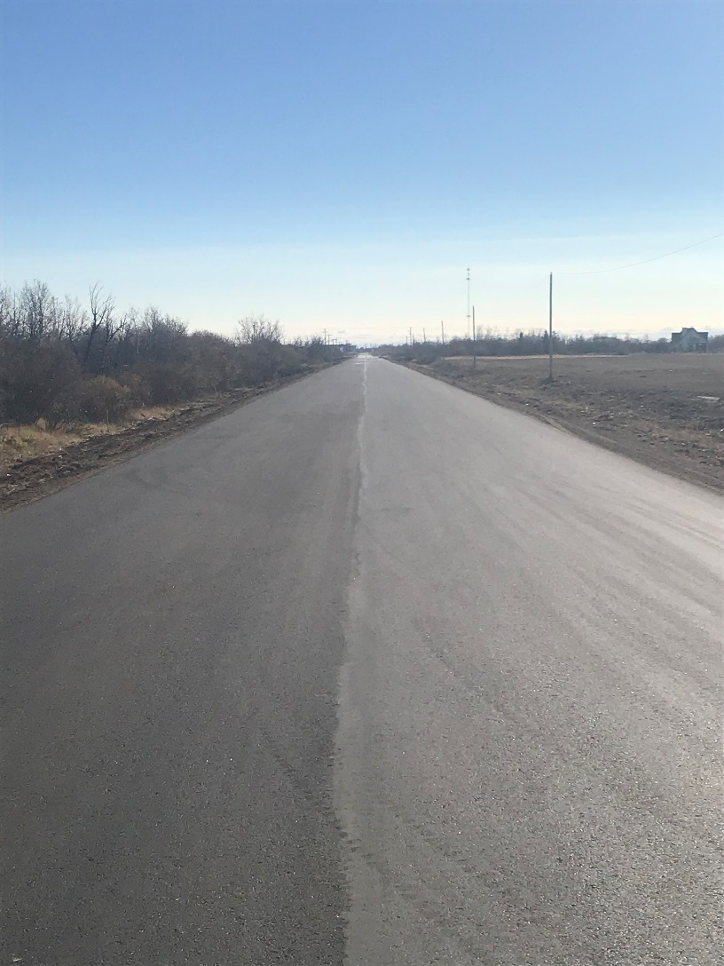
Neuhorst Road Project
Notes:
This is the recently paved Neuhorst Road Project.
All that is required now is the centerline paint.

Slide 52
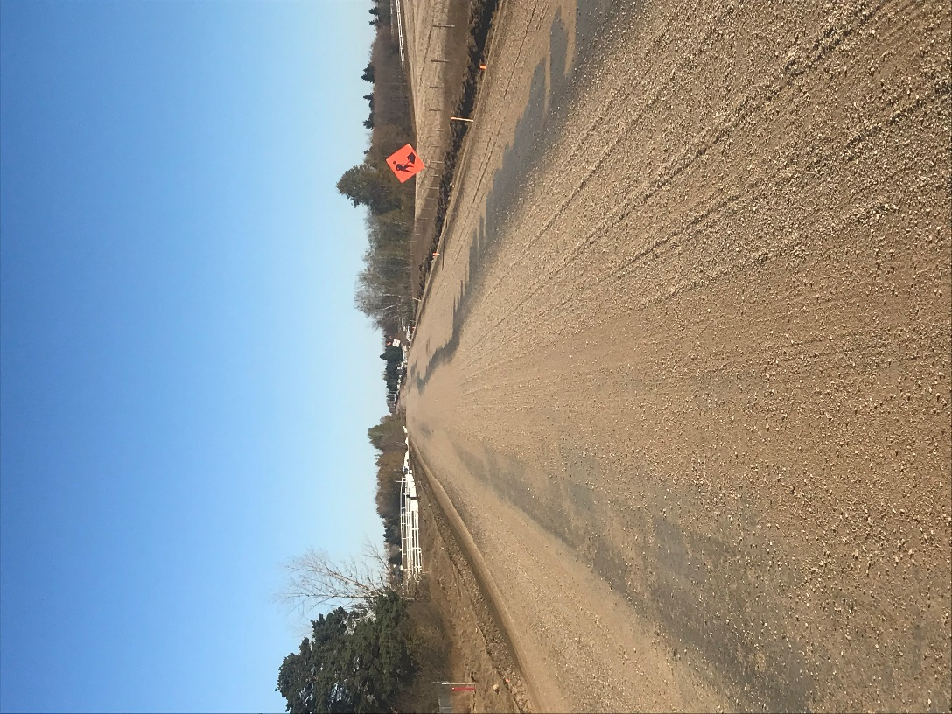
Baker Road Project
Notes:
This section of Baker Road is ready for Pavement.

Slide 53
Water Systems
5 Municipally Operated Water Systems
Riverside
Casa Rio
Grasswood
Industrial Park
Battleford Trail
4 Water Tank Fill Stations
Clarence Well
North Well
33rd street
Pasture Road – Non Potable
Notes:
Water Systems
5 Municipally Operated Water Systems
Riverside
Casa Rio
Grasswood
Industrial Park
Battleford Trail
4 Water Tank Fill Stations
Clarence Well
North Well
33rd street
Pasture Road – Non Potable

Slide 54
Recycling Program
5 Recycling Stations
Green Prairie Environmental
Osler
Langham
33rd St
Asquith – Opened in July of 2018
Notes:
Recycling Program
5 Recycling Stations
Green Prairie Environmental
Osler
Langham
33rd St
Asquith – Opened in July of 2018

Slide 55
Mowing Program
Full cut on a four year rotation
Five mowers operating during mowing program
Notes:
Mowing Program
Full cut on a four year rotation
Five mowers operating during mowing program

Slide 56
Other Services
3 Miles of Road Brushing Completed
12 New Culverts Installed
Notes:
Other Services
3 Miles of Road Brushing Completed
12 Culverts Installed

Slide 57
Planning Department
Rebecca Row
Director of Planning & Development

Slide 58
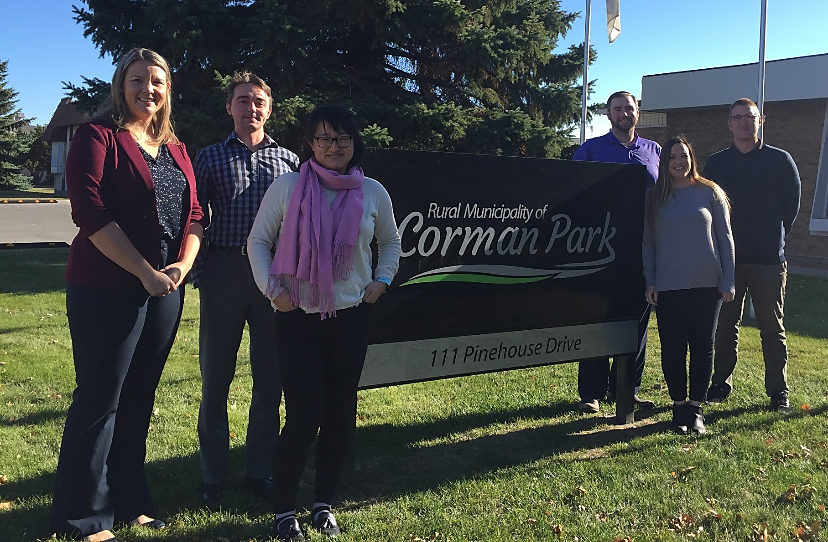
R.M. Planning Team
(Left to Right) Rebecca Row – Director of Planning, Tanner Tetreault – Planner 2, Vicky Reaney – Senior Planner, Cory Boudreau – Planner 1, Vanessa Wellsch – Planning Technician, James McKnight – Planner 2
Notes:
All of Corman Park's various planning, permitting and subdivision processes are managed by the R.M. Planning Department. The planners also provide guidance on land use and zoning to R.M. Council, ratepayers and the development industry.
Since the last AGM we have 2 new staff – Vanessa Wellsch is a temporary Planning Technician hire due to a maternity leave and Tanner Tetreault is a replacement Planner 2 position due to the previous planner relocating to Ontario.

Slide 59
R.M. Planning Overview
Zoning Compliance Certificates
Development and Building Permits
Basic Development Reviews (BDR)
Minor Subdivision and/or Rezoning Applications
Comprehensive Development Reviews (CDR)
Major Subdivision and/or Rezoning Applications
Bylaw Amendments
Map and/or Text
Notes:
Zoning Compliance Certificates confirm that a property and any buildings on it have received permits and are compliant with R.M. bylaws and setbacks. These are usually requested during real estate transactions and are recommended for all residential, agriculture and commercial/industrial properties.
An approved development permit is required in almost all instances in order to begin developing property or running a business. The RM has two development permit categories – permitted uses, which staff approve, and discretionary uses, which require Council approval.
Building permits differ from development permits in that they are required for construction and are reviewed for building code compliance.
Basic Development Reviews are required for single parcel subdivision or rezoning applications. They are intended to provide information on the site including servicing and confirmation of a safe, buildable area on the property.
Comprehensive Development Reviews are required to rezone or subdivide land for multi-parcel applications. They are more in depth and detailed than the BDRs I just spoke about as they often require technical studies such as a Traffic Impact Assessment or Geotechnical Report.
Bylaw amendments take on two forms within the R.M. Text amendments to our bylaws are required when a development standard needs changing in the Official Community Plan or Zoning Bylaw. Map amendments are done when rezoning takes place to official change and illustrate the zoning of a property.

Slide 60
Recent Statistics - Subdivisions
Notes:
I will now touch on some of our planning and development related statistics over the past few years.
Last year Corman Park approved 58 subdivisions; which was down 20% over 2016.
However 2016 was almost double our average and last year saw things return to more normal values. As of September 30 of this year, we have approved 36 subdivisions, with another 20 currently under review.

Slide 61
Recent Statistics – Development Permits
Notes:
The R.M. issued a total of 234 development permits in 2017 which included permitted and discretionary use. While down slightly over 2016, this is on pace with the six year average of 230 permits.
2016 was our busiest year of the past six years in terms of subdivisions and permits.

Slide 62
Recent Statistics – Building Permits
2018 YTD Value of Construction: $85,031,290
2018 YTD Generated Permit Fees: $370,253
2017 Value of Construction: $87,018,773
2017 Generated Permit Fees: $431,124
Notes:
We issued 220 building permits in 2017 which resulted in the strongest construction year in the past 6 years. *click*
This resulted in a construction value over $87 million which generated permit fees over $431,000. An approximate 37% increase in construction value and permit fees was seen in 2017 from 2016.
As of 10 days ago we have issued 182 building permits this year. *click* Our current year to date value of construction and permit fees are already close to equalling last year with 3 months left to go. We continue to see robust levels of construction in Corman Park.
Our building officials, Municode Services Ltd. and the R.M. Planning Department have worked closely together since 2015 to address open building permits and outstanding deficiencies. There were 118 building permits closed in 2017, and over 380 closed during the past three years.

Slide 63
Bylaw Amendments
Aggregate Resource Extraction Operation (i.e. gravel pits) Time Limits
Changed max. approval time from 2 years to 4 years
Work Camps & Other Temporary Uses
Provided for temporary uses, like a construction work camp, to be established
Industrial Districts
Created new business, light and heavy industrial Zoning Districts
Expanded list of allowable uses & reduced minimum lot sizes to 2 acres
Intensive Livestock Operations
Currently reviewing ILO setback, co-existence agreements
Country Residential Densities
Currently reviewing CR densities and minimum lot sizes
Cannabis
Currently updating bylaws for cannabis retail, wholesaling and production
Notes:
Planning staff have spent considerable time updating planning policies in both the R.M. and the Planning District bylaws. Some of more notable policy amendments from last year include:
Changing the maximum approval time from 2 years to 4 years for gravel pits
Allowed a construction work camp to be located temporarily in the R.M. and provided for other types of temporary uses to be established subject to conditions and time limits.
Completed a major overhaul to our policies on industrial development including creation of new business, light and heavy industrial Zoning Districts, expanding the types of use definitions to allow for more types of industries and reduced the minimum lot sizes to 2 acres
Council is currently reviewing ILO setback distances and the use of co-existence agreements as well as country residential densities and minimum lot sizes.
We also received provincial approval for 1 cannabis retail outlet and are updating our bylaws to allow for those uses as well as cannabis production, processing & wholesale.

Slide 64
Recent Annexation Proposals
Annexation, also referred to as ‘boundary alteration’ is the legal process of altering municipal boundaries to add territory from one municipality to another
Municipalities will negotiate tax loss compensation or other agreements (i.e. road maintenance)
The planning and zoning bylaws of the R.M. will follow the land until the annexing municipality amends its bylaws to cover the new area
Notes:
Annexation, also referred to as ‘boundary alteration’ is the legal process of altering municipal boundaries to add territory from one municipality to another.
Municipalities undertaking annexation can negotiate tax loss compensation or other agreements.
Upon the effective date of an approving order, the lands will transfer from the administrative jurisdiction of the R.M. to another municipality.

Slide 65
Notes:
The Town of Dalmeny proposed boundary alteration in 2017 encompassing 1 and ½ quarter sections east of the town highlighted in red. The annexation came into effect on March 1, 2018.

Slide 66
Recent Annexation Proposals
Notes:
Martensville proposed to annex approx. 1900 acres on the west, north and east sides of the city shown in pink and purple on this map. This annexation came into effect on April 3, 2018.

Slide 67
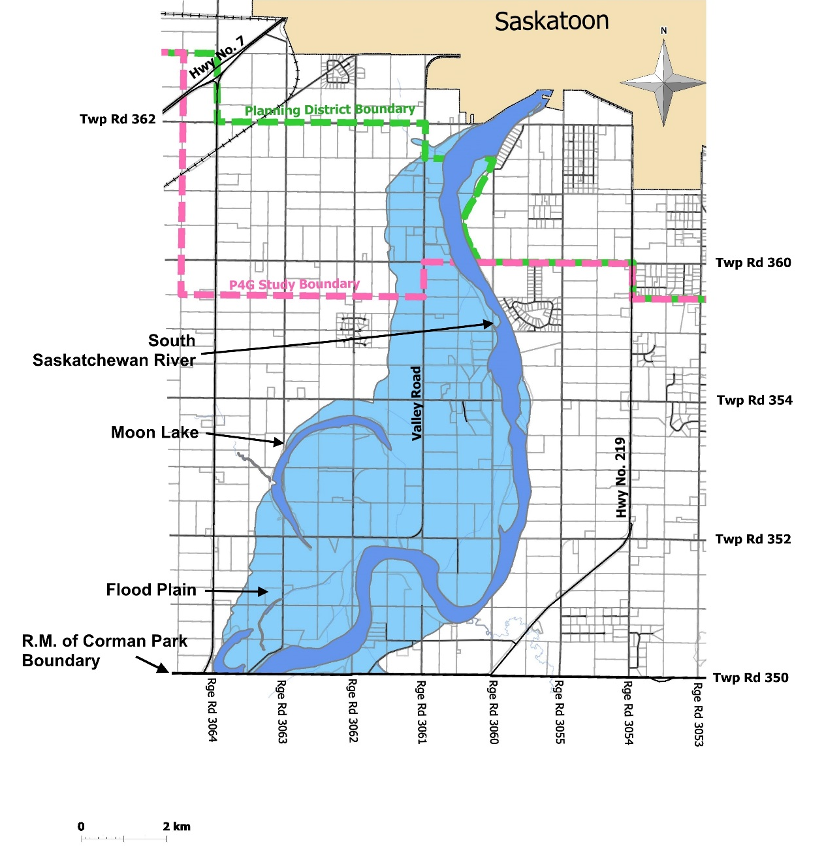
South Saskatchewan River Flood Plain
Determine floodway & flood fringe areas for 1:500 flood
Received 50% federal funding
Barr Engineering hired, project complete by March 31, 2019
Notes:
I am now going to talk about some upcoming projects, our first is related to the South Saskatchewan River flood plain, located south of the city and illustrated in blue on the map.
The modelling the province uses is out of date and labels too much of our flood plain as floodway, where no development can occur. This would mean our Moon Lake/Valley Road businesses, along with numerous residential properties could not develop or redevelop if approved today.
To help determine the flood fringe areas, where development can occur subject to site build up or other floodproofing, the R.M. decided to undertake a two-dimensional hydraulic modelling and mapping study to update provincial data. We were successful in being awarded federal government funding to pay for 50% of the project costs with the R.M. responsible for the other 50%.
In April of this year Barr Engineering was selected by R.M. Council as the lead consultant and have since completed the river survey, set up the computer model and begun to prepare mapping results.​ The project is expected to be completed in the next 3 months.
We are very excited to complete this important study in order to work with provincial agencies to allow for more development in this popular commercial, recreational and residential growth area.

Slide 68
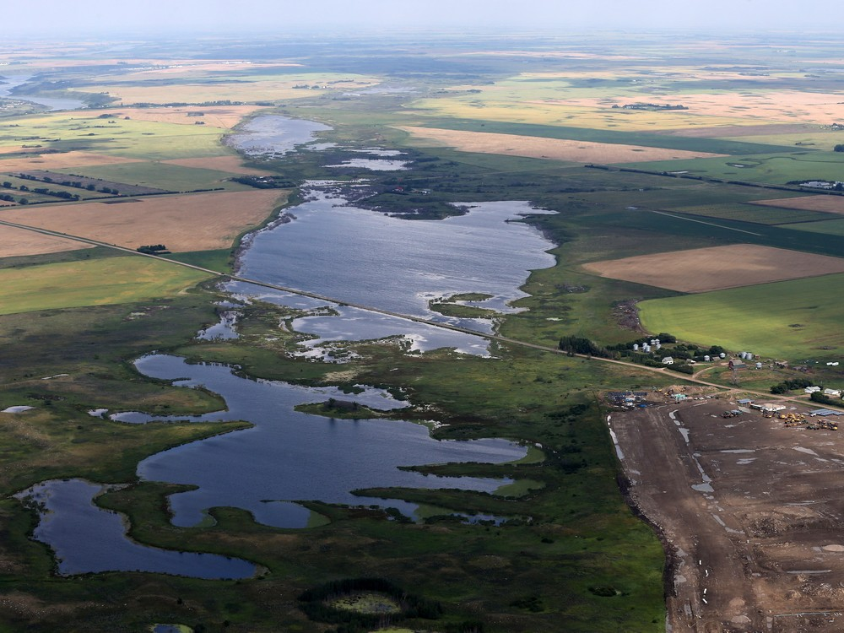
Drainage Studies
Notes:
Some projects of more regional significance include a number of master drainage studies being undertaken in Corman Park, including involvement with some of our regional partners. This image highlights the regional significance of drainage issues as we have many wetlands and drainage corridors in the RM, including what is known as the North East Swale abutting the City of Saskatoon within Corman Park.
This swale includes ecological and natural habitats and is in the middle of future growth areas; it also acts as drainage conveyance towards the South Saskatchewan river. You can see urban development pressing to the edge of this swale and rural area.

Slide 69
Notes:
Focusing on the northern part of the RM, we are working with our municipal partners to develop drainage maps to identify the 1:100 stormwater areas including the important swales, catchment areas and corridors that move water throughout the region. As a result of the analysis, development could be directed away from areas that would be flooded during a major storm, and areas that require further infrastructure work would be identified.
For example the study might confirm the size and location of needed culverts or help identify the appropriate size of a storm pond used in the site design.
This work is expected to completed within the next month and the results will be made public once available.

Slide 70
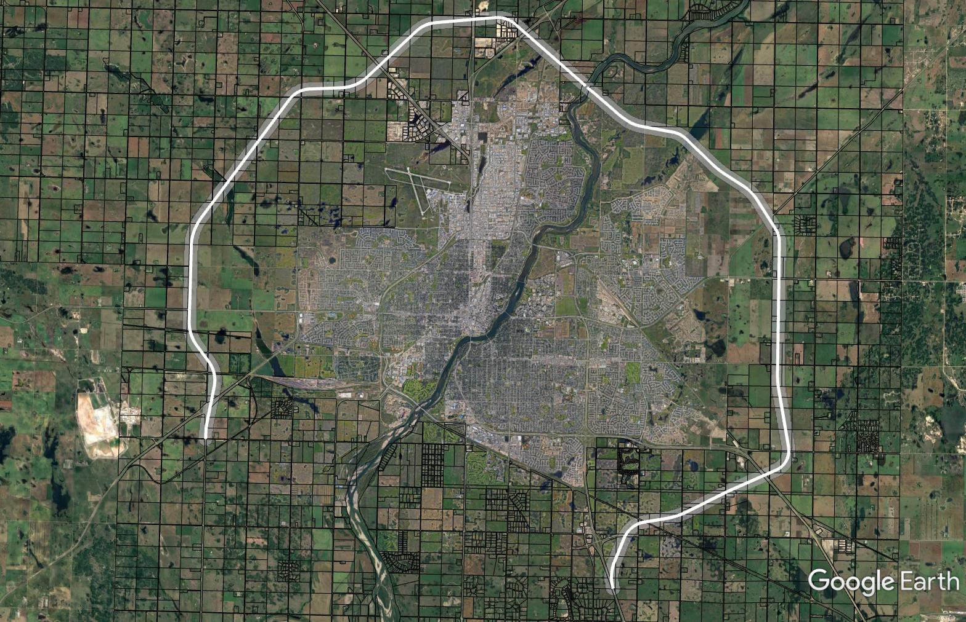
Saskatoon Freeway
Notes:
Moving onto a transportation project I’ve spoke about over the past couple years, the Ministry of Highways & Infrastructure has been undertaking work on setting the route for the Saskatoon Freeway, previously known as Perimeter Highway, since 2014. The Saskatoon Freeway alignment is shown in white.
The northern part of the alignment was confirmed in 2014 *click* but the province wanted to revisit the southwest and southeast areas.
The unconfirmed route alignments were finalized in March 2018 by the province. *click*
Currently there is a 500 m buffer area along the route where subdivision and development is restricted.
This month the province, hired a consultant to begin what is called functional planning. This functional planning will help to reduce these buffer areas as it will design the interchange configurations, show the service road alignments and generally set the design of the actual freeway. The RM is involved as part of these discussions with the Ministry of Highways & Infrastructure.
If you think your property is affected by the Freeway alignment I would encourage you to come into the office to talk to my staff about any restrictions that may be in place.

Slide 71







P4G Regional Plan
What is P4G?
Stands for Saskatoon North Partnership for Growth
Political and administrative collaborative formed in 2014
Hired consultant to complete Regional Plan
Quick Facts
4 urban and 1 rural municipality; includes representative from SREDA
Includes 11 First Nations land holdings
Some of the fastest growing municipalities in Canada
Anticipated regional population of over 500,000 in next 20 years
Regional Plan ‘endorsed in principle’ in fall 2017
Notes:
Lastly I want to talk about P4G or Saskatoon North Partnership For Growth. This group includes political and administrative representation from Corman Park, Saskatoon, Warman, Martensville, Osler as well as advisory representation from the Saskatoon Regional Economic Development Authority.
The P4G hired a project manager in 2013 and an independent consultant, O2 Planning + Design in October 2014 to complete the Regional Plan. In the fall of 2017 the P4G Regional Plan was ‘endorsed in principle’ by all of the municipalities. This endorsement has allowed development proposals in the region to be evaluated on the draft policies within the Regional Plan and move forward for approvals.
This endorsement has also allowed the R.M. to proceed with bylaw amendments to current policies to align with the P4G Regional Plan. For example, last year we expanded 5 per ¼ residential densities into the P4G study area to match agricultural areas where previously this was restricted.

Slide 72
P4G Future Land
Use Map
Project Website:
www.partnershipforgrowth.ca
Notes:
The map on the screen shows the P4G future land use map. The yellow colours show rural and urban residential areas and the purple colours show rural and urban commercial/industrial areas. The dark green is a green network study area and the lighter green area is agricultural. The grey areas show current urban boundaries.
As part of the proposed P4G Regional Plan a new Planning District is envisioned to be created. This will include expanded Planning District boundaries as well as an expanded 13 member District Planning Commission. This will replace the current Planning District we have with just Saskatoon.
In order to create the new Planning District, a new P4G Official Community Plan and P4G Zoning Bylaw must be drafted and given provincial approval. This is expected to take place in late 2019. Additional public hearings, including the consideration for a joint public hearing between the five municipal Councils, will take place at that time. Initial stages of drafting the necessary Agreement and P4G Zoning Bylaw have begun; open houses on the Zoning Bylaw project including will take place early next year.
You may have questions on P4G or the other planning studies I spoke about tonight, so please come in or call the RM office to talk to one of my staff. We don’t mind talking to you about the options available on your property. You can also visit the RM or P4G website for more information.
With that I would like to turn it over to our Chief of Police. Thank you

Slide 73
Corman Park Police Service
John Garnet
Police Chief

Slide 74
Corman Park Police Service Mandate
Mandate under the Saskatchewan Police Act
Responsibility for Provincial Statues and Municipal Bylaws as well non-injury accidents and criminal offences found in progress
Jurisdiction is the R.M. of Corman Park
However CPPS has jurisdiction in the entire Province when assisting an outside agency such as RCMP
Work closely with the RCMP, Saskatoon Police and other agencies to enhance the safety and security of the R.M.
Notes:
Mandate has been the same since the inception of CPPS. Mandate could be modified and changed if required – depends on needs of RM

Slide 75
Goals
Maintain peace in the Valley
Provide firm fair enforcement
Be there when our people need us
Protect our people and infrastructure
Notes:
Stray animal – cattle, horses
Crime prevention

Slide 76
Staff of 5 full time and 2 part-time members, 1 auxiliary and a full time executive assistant
Will respond to 1100 occurrences and issue +/- 4000 traffic related tickets

Slide 77
Statistically Speaking… Calls Tickets
2014 1310 3015
2015 1303 3216
2016 1141 3442
2017 1087 3705
2018 1114 (est) 4000 (est)

Slide 78
Calls
Call volumes have come down a bit over the years
What are we responding to? Everything…
Fires, Alarms, MVC’s, Assist General Public, Assist outside agencies, Assist RM, Wildlife calls, Suspicious occurrences, Criminal code, Littering, ATV Act, AGRA, etc.

Slide 79
Tickets
The numbers have gone up steadily
Traffic has increased
ALPR’s
Scales
More large truck work
High visibility

Slide 80
R.M. Duties and Bylaw Concerns
Assist R.M. calls:
Water issues, signage
Planning and Development
Public Works
Administrative assistance

Slide 81
Of interest
PRT
Marijuana
Nuisance Abatement
Trespassing survey

Slide 82
Summarizing CPPS
Criminal offences are to be turned over to the RCMP or other agency
CPPS have laid several criminal charges including drug and impaired driving charges and assisted with numerous stolen auto and property complaints
Occurrence numbers are about the same as last year.
Overall ticket numbers are higher for 2018
There have been no founded Police Act complaints against any CPPS member.
CPPS is within the 2018 budget.
Notes:
No complaints in three years. Emphasis on professionalism. In car video and audio.
Within budget this year. Net cost of policing has come down the last three years for the RM

Slide 83
In Rememberance
Sgt Keith Ecklund who passed away this past January
Sgt Chris Brown who passed away last month

Slide 84
New Hire
Cst Kyle Rathgeber
Sgt Warren Gherasim to Chief of Police

Slide 85

Swan Songs
Sgt Brian Fehr
Myself

Slide 86
Rural Crime Watch
Organized through the RCMP in cooperation with CPPS
You become eyes and ears
Protect yourself and your neighbors
Get current information
Reduce crime and make the RM safer
Notes:
A reminder…please join or get to know your neighbors

Slide 87
2018 Citizen of the Year Award
Presented by Reeve Judy Harwood
R.M. of Corman Park

Slide 88
please visit: www.rmcormanpark.ca Open Floor
Questions? Comments?
** We ask that all ratepayers be given a chance to speak prior to proceeding with a second round **

